Slide 1
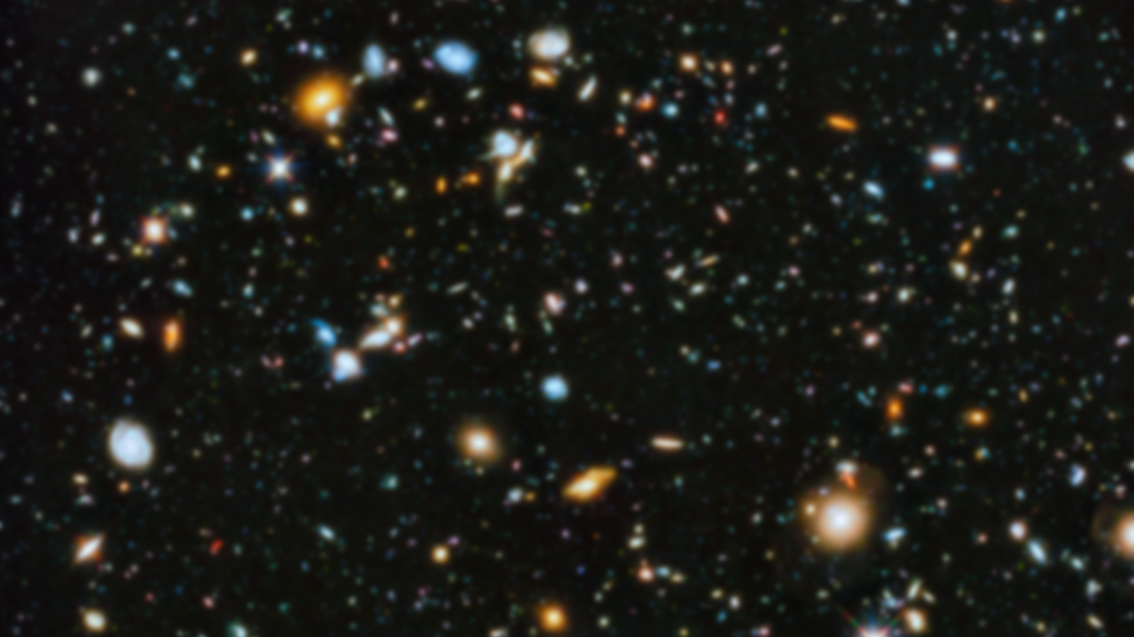
Common number systems

Slide 2
Binary | Base-2 | Radix-2
(0,1)₂

Slide 3
1 | 0 | 1 | 0 | 1 | 1 | 0 | 1

Slide 4
2⁷ | 2⁶ | 2⁵ | 2⁴ | 2³ | 2² | 2¹ | 2⁰
1 | 0 | 1 | 0 | 1 | 1 | 0 | 1

Slide 5
2⁷ | 2⁶ | 2⁵ | 2⁴ | 2³ | 2² | 2¹ | 2⁰
1 | 0 | 1 | 0 | 1 | 1 | 0 | 1
1×2⁷ | 0×2⁶ | 1×2⁵ | 0×2⁴ | 1×2³ | 1×2² | 0×2¹ | 1×2⁰
×

Slide 6
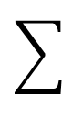
2⁷ | 2⁶ | 2⁵ | 2⁴ | 2³ | 2² | 2¹ | 2⁰
1 | 0 | 1 | 0 | 1 | 1 | 0 | 1
1×2⁷ | 0×2⁶ | 1×2⁵ | 0×2⁴ | 1×2³ | 1×2² | 0×2¹ | 1×2⁰
 |  |  |  |  |  |  |  | 173
×

Slide 7
2⁷ | 2⁶ | 2⁵ | 2⁴ | 2³ | 2² | 2¹ | 2⁰
3 | 0 | 3 | 0 | 2 | 1 | 3 | 1
 |  |  |  |  |  |  |  | -
×

Slide 8
2⁷ | 2⁶ | 2⁵ | 2⁴ | 2³ | 2² | 2¹ | 2⁰
3 | 0 | 3 | 0 | 2 | 1 | 3 | 1
- | 0×2⁶ | - | 0×2⁴ | - | 1×2² | - | 1×2⁰
 |  |  |  |  |  |  |  | Not Valid
×

Slide 9
Let’s count in binary
(░ ░ ░ ░)₂

Slide 10
Let’s count in binary
(░ ░ ░ ░)₂
0000, 0001, 0010, 00011, …, 1101, 1110, 1111

Slide 11
Increment by 1 → Increment by 0001
+ Base-2 |  |  |  | 1 | 0 | 1 | 1
 |  |  |  | 0 | 0 | 0 | 1

Slide 12
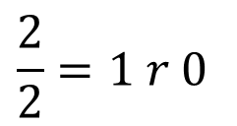
Increment by 1 → Increment by 0001
 |  |  |  |  |  | 1
+ Base-2 |  |  |  | 1 | 0 | 1 | 1
 |  |  |  | 0 | 0 | 0 | 1
 |  |  |  |  |  |  | 2→0
$$\frac{2}{2}=1 r 0$$

Slide 13
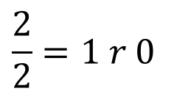
Increment by 1 → Increment by 0001
 |  |  |  |  | 1 | 1
+ Base-2 |  |  |  | 1 | 0 | 1 | 1
 |  |  |  | 0 | 0 | 0 | 1
 |  |  |  |  |  | 2→0 | 0
$$\frac{2}{2}=1 r 0$$

Slide 14
Increment by 1 → Increment by 0001
 |  |  |  |  | 1 | 1
+ Base-2 |  |  |  | 1 | 0 | 1 | 1
 |  |  |  | 0 | 0 | 0 | 1
 |  |  |  | 1 | 1 | 0 | 0

Slide 15
Octal | Base-8 | Radix-8
(0,1,2,3,4,5,6,7)₈

Slide 16
3 | 0 | 3 | 0 | 2 | 1 | 3 | 1
Notes:
0×8^9+ 0×8^8+ 3×8^7+ 3×8^6+ 3×8^5+ 3×8^8+ 2×8^3+ 1×8^2+ 3×8^1+ 1×8^0 =

Slide 17
8⁷ | 8⁶ | 8⁵ | 8⁴ | 8³ | 8² | 8¹ | 8⁰
3 | 0 | 3 | 0 | 2 | 1 | 3 | 1
Notes:
0×8^9+ 0×8^8+ 3×8^7+ 3×8^6+ 3×8^5+ 3×8^8+ 2×8^3+ 1×8^2+ 3×8^1+ 1×8^0 =

Slide 18
8⁷ | 8⁶ | 8⁵ | 8⁴ | 8³ | 8² | 8¹ | 8⁰
3 | 0 | 3 | 0 | 2 | 1 | 3 | 1
3×8⁷ | 0×8⁶ | 3×8⁵ | 0×8⁴ | 2×8³ | 1×8² | 3×8¹ | 1×8⁰
×
Notes:
0×8^9+ 0×8^8+ 3×8^7+ 3×8^6+ 3×8^5+ 3×8^8+ 2×8^3+ 1×8^2+ 3×8^1+ 1×8^0 =

Slide 19
8⁷ | 8⁶ | 8⁵ | 8⁴ | 8³ | 8² | 8¹ | 8⁰
3 | 0 | 3 | 0 | 2 | 1 | 3 | 1
3×8⁷ | 0×8⁶ | 3×8⁵ | 0×8⁴ | 2×8³ | 1×8² | 3×8¹ | 1×8⁰
 |  |  |  |  |  |  |  | 6,390,873
×
Notes:
3×8^7+ 0×8^6+ 3×8^5+ 0×8^4+ 2×8^3+ 1×8^2+ 3×8^1+ 1×8^0 =

Slide 20
8⁷ | 8⁶ | 8⁵ | 8⁴ | 8³ | 8² | 8¹ | 8⁰
3 | 0 | A | 0 | 8 | 1 | 3 | 1
×

Slide 21
8⁷ | 8⁶ | 8⁵ | 8⁴ | 8³ | 8² | 8¹ | 8⁰
3 | 0 | A | 0 | 8 | 1 | 3 | 1
3×8⁷ | 0×8⁶ | - | 0×8⁴ | - | 1×8² | 3×8¹ | 1×8⁰
 |  |  |  |  |  |  |  | Not Valid
×

Slide 22
8⁷ | 8⁶ | 8⁵ | 8⁴ | 8³ | 8² | 8¹ | 8⁰
1 | 0 | 1 | 0 | 1 | 1 | 0 | 1
1×8⁷ | 0×8⁶ | 1×8⁵ | 0×8⁴ | 1×8³ | 1×8² | 0×8¹ | 1×8⁰
 |  |  |  |  |  |  |  | 2,130,497
×

Slide 23
8⁷ | 8⁶ | 8⁵ | 8⁴ | 8³ | 8² | 8¹ | 8⁰
1 | 0 | 1 | 0 | 1 | 1 | 0 | 1
1×8⁷ | 0×8⁶ | 1×8⁵ | 0×8⁴ | 1×8³ | 1×8² | 0×8¹ | 1×8⁰
 |  |  |  |  |  |  |  | 2,130,497
Radix-8
vs.
Radix-2
2⁷ | 2⁶ | 2⁵ | 2⁴ | 2³ | 2² | 2¹ | 2⁰
1 | 0 | 1 | 0 | 1 | 1 | 0 | 1
1×2⁷ | 0×2⁶ | 1×2⁵ | 0×2⁴ | 1×2³ | 1×2² | 0×2¹ | 1×2⁰
 |  |  |  |  |  |  |  | 173

Slide 24
Let’s count in octal
(░ ░ ░ ░)₈

Slide 25
Let’s count in octal
(░ ░ ░ ░)₈
0000, 0001, 0002, …, 0007, 0010, …, 7775, 7776, 7777

Slide 26
Increment by 1 → Increment by 0001
+ Base-8 |  |  |  | 5 | 2 | 7 | 7
 |  |  |  | 0 | 0 | 0 | 1

Slide 27
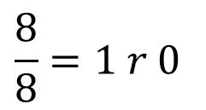
Increment by 1 → Increment by 0001
 |  |  |  |  |  | 1
+ Base-8 |  |  |  | 5 | 2 | 7 | 7
 |  |  |  | 0 | 0 | 0 | 1
 |  |  |  |  |  |  | 8→0
$$\frac{8}{8}=1 r 0$$

Slide 28
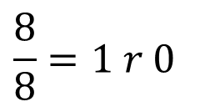
Increment by 1 → Increment by 0001
 |  |  |  |  | 1 | 1
+ Base-8 |  |  |  | 5 | 2 | 7 | 7
 |  |  |  | 0 | 0 | 0 | 1
 |  |  |  |  |  | 8→0 | 0
$$\frac{8}{8}=1 r 0$$

Slide 29
Increment by 1 → Increment by 0001
 |  |  |  |  | 1 | 1
+ Base-8 |  |  |  | 5 | 2 | 7 | 7
 |  |  |  | 0 | 0 | 0 | 1
 |  |  |  | 5 | 3 | 0 | 0

Slide 30
Decimal | Base-10 | Radix-10
(0,1,2,3,4,5,6,7,9)₁₀

Slide 31
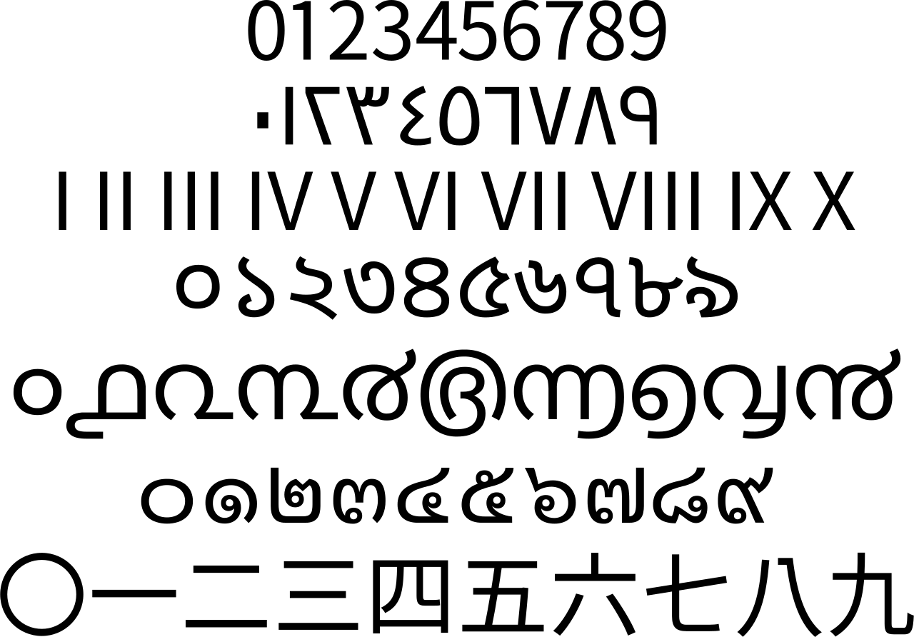
Notes:
Arabic numerals
Eastern Arabic numerals
Roman numerals (Roman numerals are a numeral system that originated in ancient Rome )
Bengali–Assamese numerals
Malayalam numerals
Thai numerals
Chinese numerals

Slide 32
3 | 0 | 3 | 0 | 2 | 1 | 3 | 1
Notes:
3×10^7+ 3×10^6+ 3×10^5+ 3×10^10+ 2×10^3+ 1×10^2+ 3×10^1+ 1×10^0 =

Slide 33
10⁷ | 10⁶ | 10⁵ | 10⁴ | 10³ | 10² | 10¹ | 10⁰
3 | 0 | 3 | 0 | 2 | 1 | 3 | 1
Notes:
3×10^7+ 3×10^6+ 3×10^5+ 3×10^10+ 2×10^3+ 1×10^2+ 3×10^1+ 1×10^0 =

Slide 34
10⁷ | 10⁶ | 10⁵ | 10⁴ | 10³ | 10² | 10¹ | 10⁰
3 | 0 | 3 | 0 | 2 | 1 | 3 | 1
3×10⁷ | 0×10⁶ | 3×10⁵ | 0×10⁴ | 2×10³ | 1×10² | 3×10¹ | 1×10⁰
×
Notes:
3×10^7+ 3×10^6+ 3×10^5+ 3×10^10+ 2×10^3+ 1×10^2+ 3×10^1+ 1×10^0 =

Slide 35
10⁷ | 10⁶ | 10⁵ | 10⁴ | 10³ | 10² | 10¹ | 10⁰
3 | 0 | 3 | 0 | 2 | 1 | 3 | 1
3×10⁷ | 0×10⁶ | 3×10⁵ | 0×10⁴ | 2×10³ | 1×10² | 3×10¹ | 1×10⁰
 |  |  |  |  |  |  |  | 30,302,131
×
Notes:
3×10^7+ 3×10^6+ 3×10^5+ 3×10^10+ 2×10^3+ 1×10^2+ 3×10^1+ 1×10^0 =

Slide 36
10⁷ | 10⁶ | 10⁵ | 10⁴ | 10³ | 10² | 10¹ | 10⁰
3 | 0 | 3 | 0 | 2 | 1 | 3 | 1
3×10⁷ | 0×10⁶ | 3×10⁵ | 0×10⁴ | 2×10³ | 1×10² | 3×10¹ | 1×10⁰
 |  |  |  |  |  |  |  | 30,302,131
×
Notes:
3×10^7+ 3×10^6+ 3×10^5+ 3×10^10+ 2×10^3+ 1×10^2+ 3×10^1+ 1×10^0 =

Slide 37
10⁷ | 10⁶ | 10⁵ | 10⁴ | 10³ | 10² | 10¹ | 10⁰
1 | 0 | 1 | 0 | 1 | 1 | 0 | 1
1×10⁷ | 0×10⁶ | 1×10⁵ | 0×10⁴ | 1×10³ | 1×10² | 0×10¹ | 1×10⁰
 |  |  |  |  |  |  |  | 10,101,101
×

Slide 38
10⁷ | 10⁶ | 10⁵ | 10⁴ | 10³ | 10² | 10¹ | 10⁰
1 | 0 | 1 | 0 | 1 | 1 | 0 | 1
1×10⁷ | 0×10⁶ | 1×10⁵ | 0×10⁴ | 1×10³ | 1×10² | 0×10¹ | 1×10⁰
 |  |  |  |  |  |  |  | 10,101,101
8⁷ | 8⁶ | 8⁵ | 8⁴ | 8³ | 8² | 8¹ | 8⁰
1 | 0 | 1 | 0 | 1 | 1 | 0 | 1
1×8⁷ | 0×8⁶ | 1×8⁵ | 0×8⁴ | 1×8³ | 1×8² | 0×8¹ | 1×8⁰
 |  |  |  |  |  |  |  | 2,130,497
2⁷ | 2⁶ | 2⁵ | 2⁴ | 2³ | 2² | 2¹ | 2⁰
1 | 0 | 1 | 0 | 1 | 1 | 0 | 1
1×2⁷ | 0×2⁶ | 1×2⁵ | 0×2⁴ | 1×2³ | 1×2² | 0×2¹ | 1×2⁰
 |  |  |  |  |  |  |  | 173

Slide 39
10⁷ | 10⁶ | 10⁵ | 10⁴ | 10³ | 10² | 10¹ | 10⁰
3 | 0 | A | 0 | 8 | 1 | 3 | 1
×

Slide 40
10⁷ | 10⁶ | 10⁵ | 10⁴ | 10³ | 10² | 10¹ | 10⁰
3 | 0 | A | 0 | 8 | 1 | 3 | 1
3×10⁷ | 0×10⁶ | - | 0×10⁴ | 8×10³ | 1×10² | 3×10¹ | 1×10⁰
 |  |  |  |  |  |  |  | Not Valid
×

Slide 41
you know how to count in decimal!
(░ ░ ░ ░)₁₀

Slide 42
Hexadecimal | Base-16 | Radix-16
(0,1,2,3,4,5,6,7,9,A,B,C,D,E,F)₁₆

Slide 43
16⁷ | 16⁶ | 16⁵ | 16⁴ | 16³ | 16² | 16¹ | 16⁰
3 | 0 | A | 0 | 9 | 1 | 3 | 1
×
Notes:
(30302131)₁₆ = (3 × 16⁷) + (0 × 16⁶) + (3 × 16⁵) + (0 × 16⁴) + (2 × 16³) + (1 × 16²) + (3 × 16¹) + (1 × 16⁰) = (808460593)₁₀

Slide 44
16⁷ | 16⁶ | 16⁵ | 16⁴ | 16³ | 16² | 16¹ | 16⁰
3 | 0 | A | 0 | 9 | 1 | 3 | 1
3×16⁷ | 0×16⁶ | A×16⁵ | 0×16⁴ | 9×16³ | 1×16² | 3×16¹ | 1×16⁰
×
Notes:
0×16^9+ 0×16^16+ 3×16^7+ 3×16^6+ 10×16^5+ 3×16^16+ 9×16^3+ 1×16^2+ 3×16^1+ 1×16^0 =

Slide 45
16⁷ | 16⁶ | 16⁵ | 16⁴ | 16³ | 16² | 16¹ | 16⁰
3 | 0 | A | 0 | 9 | 1 | 3 | 1
3×16⁷ | 0×16⁶ | A×16⁵ | 0×16⁴ | 9×16³ | 1×16² | 3×16¹ | 1×16⁰
×
A = (9 + 1) = (10)₁₀
Notes:
0×16^9+ 0×16^16+ 3×16^7+ 3×16^6+ 10×16^5+ 3×16^16+ 9×16^3+ 1×16^2+ 3×16^1+ 1×16^0 =

Slide 46
16⁷ | 16⁶ | 16⁵ | 16⁴ | 16³ | 16² | 16¹ | 16⁰
3 | 0 | A | 0 | 9 | 1 | 3 | 1
3×16⁷ | 0×16⁶ | A×16⁵ | 0×16⁴ | 9×16³ | 1×16² | 3×16¹ | 1×16⁰
 |  |  |  |  |  |  |  | 815,829,297
×
A = (9 + 1) = (10)₁₀
Notes:
(30A09131)₁₆ = (3 × 16⁷) + (0 × 16⁶) + (10 × 16⁵) + (0 × 16⁴) + (9 × 16³) + (1 × 16²) + (3 × 16¹) + (1 × 16⁰) = (815829297)₁₀

Slide 47
1,2,3,4,5,6,7,8,9,A
1,2,3,4,5,6,7,8,9,B
1,2,3,4,5,6,7,8,9,C
1,2,3,4,5,6,7,8,9,D
1,2,3,4,5,6,7,8,9,E
1,2,3,4,5,6,7,8,9,F
= 9 + 1
= A + 1
= B + 1
= C + 1
= D + 1
= E + 1
= (10)₁₀
= (11)₁₀
= (12)₁₀
= (13)₁₀
= (14)₁₀
= (15)₁₀

Slide 48
16⁷ | 16⁶ | 16⁵ | 16⁴ | 16³ | 16² | 16¹ | 16⁰
1 | 0 | 1 | 0 | 1 | 1 | 0 | 1
1×16⁷ | 0×16⁶ | 1×16⁵ | 0×16⁴ | 1×16³ | 1×16² | 0×16¹ | 1×16⁰
 |  |  |  |  |  |  |  | 269,488,385
×

Slide 49
16⁷ | 16⁶ | 16⁵ | 16⁴ | 16³ | 16² | 16¹ | 16⁰
1 | 0 | 1 | 0 | 1 | 1 | 0 | 1
1×16⁷ | 0×16⁶ | 1×16⁵ | 0×16⁴ | 1×16³ | 1×16² | 0×16¹ | 1×16⁰
 |  |  |  |  |  |  |  | 269,488,385
10⁷ | 10⁶ | 10⁵ | 10⁴ | 10³ | 10² | 10¹ | 10⁰
1 | 0 | 1 | 0 | 1 | 1 | 0 | 1
1×10⁷ | 0×10⁶ | 1×10⁵ | 0×10⁴ | 1×10³ | 1×10² | 0×10¹ | 1×10⁰
 |  |  |  |  |  |  |  | 10,101,101
8⁷ | 8⁶ | 8⁵ | 8⁴ | 8³ | 8² | 8¹ | 8⁰
1 | 0 | 1 | 0 | 1 | 1 | 0 | 1
1×8⁷ | 0×8⁶ | 1×8⁵ | 0×8⁴ | 1×8³ | 1×8² | 0×8¹ | 1×8⁰
 |  |  |  |  |  |  |  | 2,130,497
2⁷ | 2⁶ | 2⁵ | 2⁴ | 2³ | 2² | 2¹ | 2⁰
1 | 0 | 1 | 0 | 1 | 1 | 0 | 1
1×2⁷ | 0×2⁶ | 1×2⁵ | 0×2⁴ | 1×2³ | 1×2² | 0×2¹ | 1×2⁰
 |  |  |  |  |  |  |  | 173
Notes:
Add a diagram to show the growth

Slide 50
Let’s count in base-16
(░ ░ ░ ░)₁₆

Slide 51
Let’s count in base-16
(░ ░ ░ ░)₁₆
0000, 0001, 0002, …, 000F, 0010, …, FFFD, FFFE, FFFF

Slide 52
Increment by 1 → Increment by 0001
+ Base-16 |  |  |  | 5 | C | A | F
 |  |  |  | 0 | 0 | 0 | 1

Slide 53
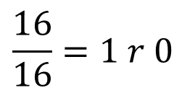
Increment by 1 → Increment by 0001
 |  |  |  |  |  | 1
+ Base-16 |  |  |  | 5 | C | A | F=15
 |  |  |  | 0 | 0 | 0 | 1
 |  |  |  |  |  |  | 16→0
$$\frac{16}{16}=1 r 0$$

Slide 54
Increment by 1 → Increment by 0001
 |  |  |  |  |  | 1
+ Base-16 |  |  |  | 5 | C | A=10 | F=15
 |  |  |  | 0 | 0 | 0 | 1
 |  |  |  |  |  | 11→B | 0

Slide 55
Increment by 1 → Increment by 0001
 |  |  |  |  |  | 1
+ Base-16 |  |  |  | 5 | C | A=10 | F=15
 |  |  |  | 0 | 0 | 0 | 1
 |  |  |  | 5 | C | B | 0

Slide 56
Base-64 | Radix-64
(A,B,C, …,Z, a,b,c,…,z,0,1,2,…,9,+,/)₆₄
1992: RFC 1341
MIME (Multipurpose Internet Mail Extensions)
Mechanisms For Specifying And Describing The Format Of Internet Message Bodies

Slide 57
Digit | Value | → | Digit | Value | → | Digit | Value | → | Digit | Value
A | 0 |  | Q | 16 |  | g | 32 |  | w | 48
B | 1 |  | R | 17 |  | h | 33 |  | x | 49
C | 2 |  | S | 18 |  | i | 34 |  | y | 50
D | 3 |  | T | 19 |  | j | 35 |  | z | 51
E | 4 |  | U | 20 |  | k | 36 |  | 0 | 52
F | 5 |  | V | 21 |  | l | 37 |  | 1 | 53
G | 6 |  | W | 22 |  | m | 38 |  | 2 | 54
H | 7 |  | X | 23 |  | n | 39 |  | 3 | 55
I | 8 |  | Y | 24 |  | o | 40 |  | 4 | 56
J | 9 |  | Z | 25 |  | p | 41 |  | 5 | 57
K | 10 |  | a | 26 |  | q | 42 |  | 6 | 58
L | 11 |  | b | 27 |  | r | 43 |  | 7 | 59
M | 12 |  | c | 28 |  | s | 44 |  | 8 | 60
N | 13 |  | d | 29 |  | t | 45 |  | 9 | 61
O | 14 |  | e | 30 |  | u | 46 |  | + | 62
P | 15 |  | f | 31 |  | v | 47 |  | / | 63

Slide 58
3 | a | A | / | d | 1 | H | +

Slide 59
64⁷ | 64⁶ | 64⁵ | 64⁴ | 64³ | 64² | 64¹ | 64⁰
3 | a | A | / | d | 1 | H | +
×

Slide 60
Digit | Value | → | Digit | Value | → | Digit | Value | → | Digit | Value
A | 0 |  | Q | 16 |  | g | 32 |  | w | 48
B | 1 |  | R | 17 |  | h | 33 |  | x | 49
C | 2 |  | S | 18 |  | i | 34 |  | y | 50
D | 3 |  | T | 19 |  | j | 35 |  | z | 51
E | 4 |  | U | 20 |  | k | 36 |  | 0 | 52
F | 5 |  | V | 21 |  | l | 37 |  | 1 | 53
G | 6 |  | W | 22 |  | m | 38 |  | 2 | 54
H | 7 |  | X | 23 |  | n | 39 |  | 3 | 55
I | 8 |  | Y | 24 |  | o | 40 |  | 4 | 56
J | 9 |  | Z | 25 |  | p | 41 |  | 5 | 57
K | 10 |  | a | 26 |  | q | 42 |  | 6 | 58
L | 11 |  | b | 27 |  | r | 43 |  | 7 | 59
M | 12 |  | c | 28 |  | s | 44 |  | 8 | 60
N | 13 |  | d | 29 |  | t | 45 |  | 9 | 61
O | 14 |  | e | 30 |  | u | 46 |  | + | 62
P | 15 |  | f | 31 |  | v | 47 |  | / | 63

Slide 61
64⁷ | 64⁶ | 64⁵ | 64⁴ | 64³ | 64² | 64¹ | 64⁰
3 | a | A | / | d | 1 | H | +
55 ×64⁷ | 26 ×64⁶ | 0 ×64⁵ | 63 ×64⁴ | 29 ×64³ | 53 ×64² | 7 ×64¹ | 62 ×64⁰
×

Slide 62
64⁷ | 64⁶ | 64⁵ | 64⁴ | 64³ | 64² | 64¹ | 64⁰
3 | a | A | / | d | 1 | H | +
55 ×64⁷ | 26 ×64⁶ | 0 ×64⁵ | 63 ×64⁴ | 29 ×64³ | 53 ×64² | 7 ×64¹ | 62 ×64⁰
 |  |  |  |  |  |  |  | 243,680,329,290,238
×
Notes:
55*64^7+26*64^6+0*64^5+63*64^4+29*64^3+53*64^2+7*64^1+62*64^0

Slide 63
Let’s count in base-64
(░ ░ ░ ░)₆₄

Slide 64
Let’s count in base-64
(░ ░ ░ ░)₆₄
AAAA, AAAB, AAAC, …, AAA/, AABA, …, ///9, ///+, ////

Slide 65
Increment by 1 → Increment by AAAB
+ Base-64 |  |  |  | a | + | Z | /
 |  |  |  | A=0 | A=0 | A=0 | B=1

Slide 66
Increment by 1 → Increment by AAAB
+ Base-64 |  |  |  | a=26 | +=62 | Z=25 | /=63
 |  |  |  | A=0 | A=0 | A=0 | B=1

Slide 67
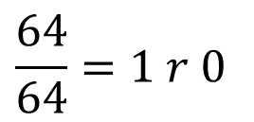
 |  |  |  |  |  | B=1
+ Base-64 |  |  |  | a=26 | +=62 | Z=25 | /=63
 |  |  |  | A=0 | A=0 | A=0 | B=1
 |  |  |  |  |  |  | A=0
$$\frac{64}{64}=1 r 0$$

Slide 68
 |  |  |  |  |  | B=1
+ Base-64 |  |  |  | a=26 | +=62 | Z=25 | /=63
 |  |  |  | A=0 | A=0 | A=0 | B=1
 |  |  |  | a | + | a=26 | A=0

Slide 69
Radix-r number system
aka. Base-r Number System
Hossein’s number system is not a Radix-r number system!

Slide 70
Let (N)_{r} be a radix-r (base-r) number in a positional weighting number system, then
(N)_{r} = (d_{n-1} r^{n-1} + d_{n-2} r^{n-2} + ... + d_{i} r^{i} + ... + d₂ r² + d₁ r¹ + d₀r⁰)₁₀
where:
r = radix (base)
d_{i} = digit at position i, 0 ≤ d_{i} ≤ r - 1
r^{i} = weight (significance) of position i
n = number of digits in N

Slide 71
Let (N)_{r} be a radix-r (base-r) number in a positional weighting number system, then
(N)_{r} = (d_{n-1} r^{n-1} + d_{n-2} r^{n-2} + ... + d_{i} r^{i} + ... + d₂ r² + d₁ r¹ + d₀r⁰)₁₀
where:
r = radix (base)
d_{i} = digit at position i, 0 ≤ d_{i} ≤ r - 1
r^{i} = weight (significance) of position i
n = number of digits in N

Slide 72
Let (N)_{r} be a radix-r (base-r) number in a positional weighting number system, then
Min = (0_{n-1}0_{n-2} ... 0₁0₀)_{r} = (0)₁₀
Max = ((r-1)_{n-1}(r-1)_{n-2} ... (r-1)₁(r-1)₀)_{r} = (r^{n}-1)₁₀
Unit = (0_{n-1}0_{n-2} ... 0₁1₀)_{r} = (1)₁₀
where:
r = radix (base)
r^{i} = weight of position i
n = number of digits in N

Slide 73
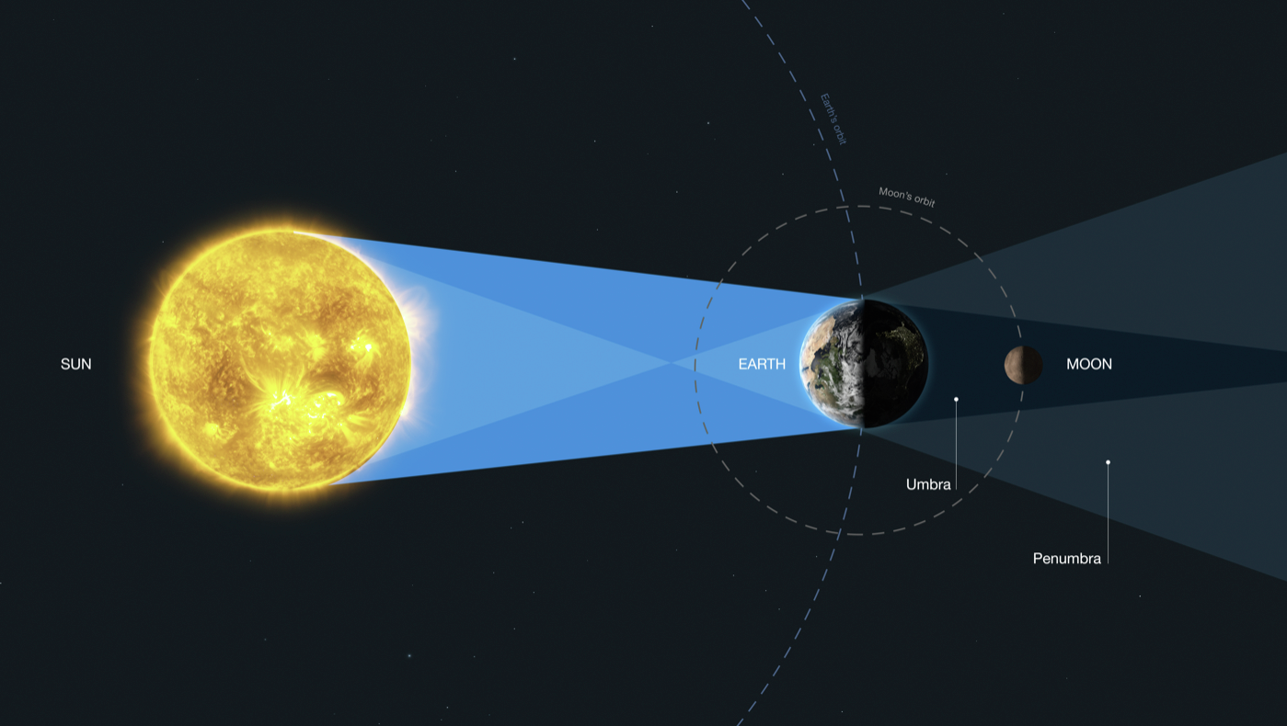
Moon’s Distance to Sun: (10.?)₄ = (4.5)₁₀
Notes:
Earth’s 12,742 km

Slide 74
Fraction

Slide 75
1 Earth
Moon’s Distance to Sun
Notes:
Earth’s 12,742 km

Slide 76
Fraction Point
Radix-4 (Base-4) = 1/4 Earth = 4⁻¹ Earth = (.1)₄
Moon’s Distance to Sun
Notes:
Earth’s 12,742 km

Slide 77
Radix-4 (Base-4) = 2 × 1/4 Earth = 2 × 4⁻¹ Earth=(.2)₄
Moon’s Distance to Sun
Notes:
Earth’s 12,742 km

Slide 78
Radix-4 (Base-4) = 3 × 1/4 Earth = 3 × 4⁻¹ Earth=(.3)₄
Moon’s Distance to Sun
Notes:
Earth’s 12,742 km

Slide 79
Radix-4 (Base-4) = 4 × 1/4 Earth = 4 × 4⁻¹ Earth=(1)₄
Moon’s Distance to Sun
Notes:
Earth’s 12,742 km

Slide 80
(10)₄
(3)₄
(2)₄
(1)₄
1/4
1/4
0
Moon’s Distance to Sun in Radix-4: (10 . 2)₄
Notes:
Earth’s 12,742 km

Slide 81
More precision

Slide 82
Radix-4 (Base-4) = 1/4 Earth = 4⁻¹ Earth = (.1)₄
Moon’s Distance to Sun
Notes:
Earth’s 12,742 km

Slide 83
Radix-4 (Base-4) = (1/4)/4 Earth = 1/16 Earth = 4⁻² Earth
Moon’s Distance to Sun
Notes:
Earth’s 12,742 km

Slide 84
Radix-4 (Base-4) = 1/16 = 4⁻² Earth = (.01)₄
Moon’s Distance to Sun
Notes:
Earth’s 12,742 km

Slide 85
Radix-4 (Base-4) = 2 × 1/16 = 2 × 4⁻² Earth = (.02)₄
Moon’s Distance to Sun
Notes:
Earth’s 12,742 km

Slide 86
Radix-4 (Base-4) = 3 × 1/16 = 3 × 4⁻² Earth = (.03)₄
Moon’s Distance to Sun
Notes:
Earth’s 12,742 km

Slide 87
Radix-4 (Base-4) = 4 × 1/16 = 4 × 4⁻² Earth = (.1)₄
Moon’s Distance to Sun
Notes:
Earth’s 12,742 km

Slide 88
(10)₄
(3)₄
(2)₄
(1)₄
1/4
1/4
0
1/16
Moon’s Distance to Sun in Radix-4: (10 . 21)₄
Notes:
Earth’s 12,742 km

Slide 89
Integer Part
Fraction Part
.
1 | 0 | 1 | 0 | 2 | 3 | 0 | 1 | 2 | 0 | 1 | 0 | 1
Fraction Point
We don’t waste a position for the fraction point.
It’s location is defined already.

Slide 90
Integer Part
Fraction Part
4⁷ | 4⁶ | 4⁵ | 4⁴ | 4³ | 4² | 4¹ | 4⁰ | . | 4⁻¹ | 4⁻² | 4⁻³ | 4⁻⁴ | 4⁻⁵
1 | 0 | 1 | 0 | 2 | 3 | 0 | 1 |  | 2 | 0 | 1 | 0 | 1

Slide 91
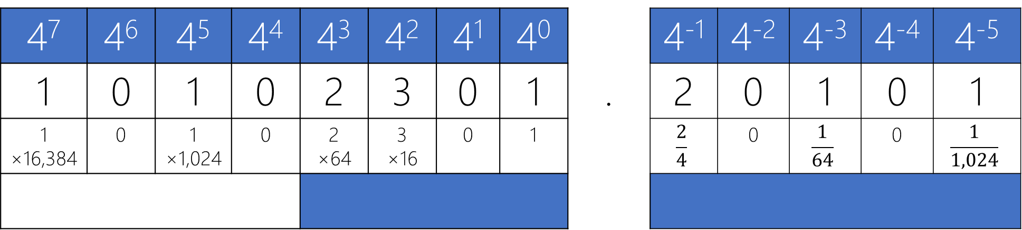
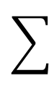
Integer Part
Fraction Part
4⁷ | 4⁶ | 4⁵ | 4⁴ | 4³ | 4² | 4¹ | 4⁰ | . | 4⁻¹ | 4⁻² | 4⁻³ | 4⁻⁴ | 4⁻⁵
1 | 0 | 1 | 0 | 2 | 3 | 0 | 1 |  | 2 | 0 | 1 | 0 | 1
1 ×16,384 | 0 | 1 ×1,024 | 0 | 2 ×64 | 3 ×16 | 0 | 1 |  | $$\frac{2}{4}$$ | 0 | $$\frac{1}{64}$$ | 0 | $$\frac{1}{1,024}$$
×

Slide 92
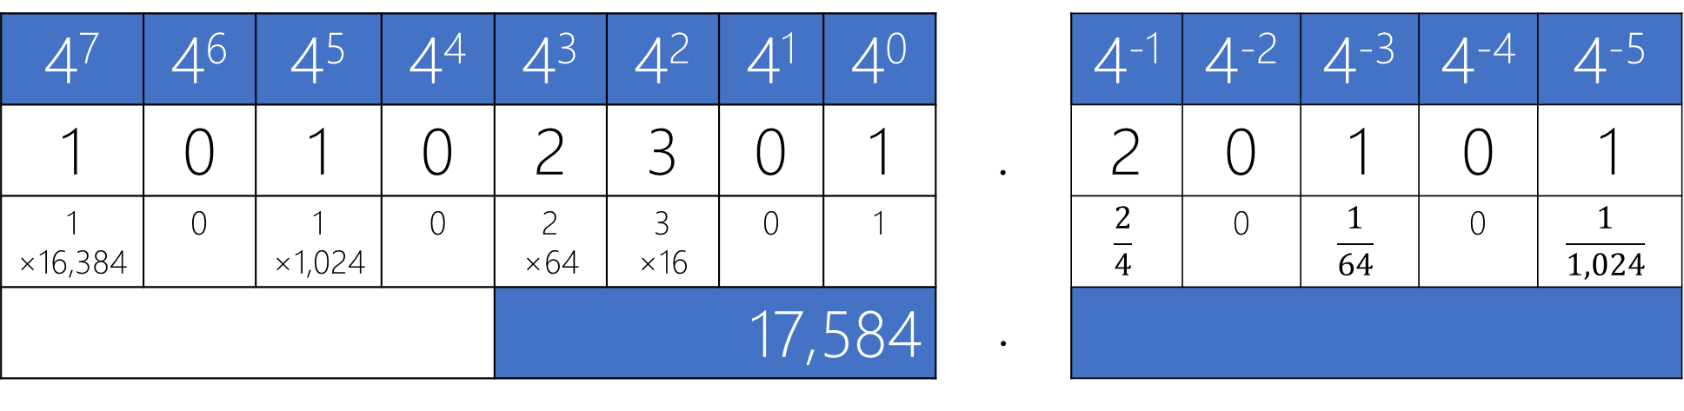
Integer Part
Fraction Part
4⁷ | 4⁶ | 4⁵ | 4⁴ | 4³ | 4² | 4¹ | 4⁰ | . | 4⁻¹ | 4⁻² | 4⁻³ | 4⁻⁴ | 4⁻⁵
1 | 0 | 1 | 0 | 2 | 3 | 0 | 1 |  | 2 | 0 | 1 | 0 | 1
1 ×16,384 | 0 | 1 ×1,024 | 0 | 2 ×64 | 3 ×16 | 0 | 1 |  | $$\frac{2}{4}$$ | 0 | $$\frac{1}{64}$$ | 0 | $$\frac{1}{1,024}$$
 |  |  |  | 17,584 |  |  |  | .
×
Notes:
1*4^7+1*4^5+2*4^3+3*4^2+1*4^0

Slide 93
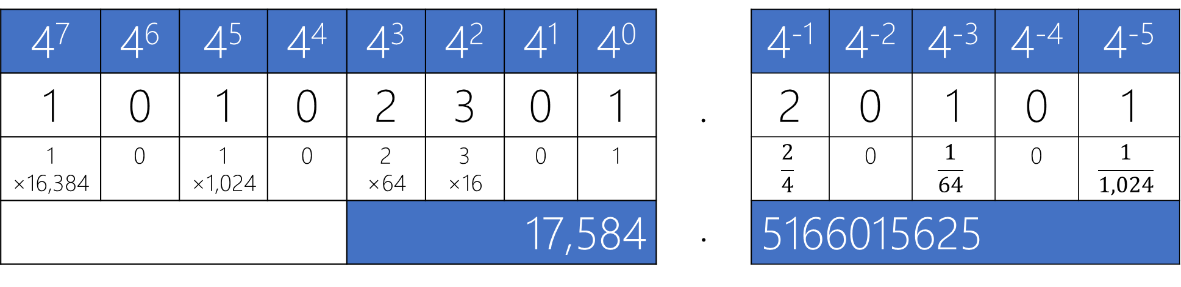
Integer Part
Fraction Part
4⁷ | 4⁶ | 4⁵ | 4⁴ | 4³ | 4² | 4¹ | 4⁰ | . | 4⁻¹ | 4⁻² | 4⁻³ | 4⁻⁴ | 4⁻⁵
1 | 0 | 1 | 0 | 2 | 3 | 0 | 1 |  | 2 | 0 | 1 | 0 | 1
1 ×16,384 | 0 | 1 ×1,024 | 0 | 2 ×64 | 3 ×16 | 0 | 1 |  | $$\frac{2}{4}$$ | 0 | $$\frac{1}{64}$$ | 0 | $$\frac{1}{1,024}$$
 |  |  |  | 17,584 |  |  |  | . | 5166015625
×

Slide 94
Let (N)_{r} be a radix-r (base-r) number in a positional weighting number system, then
(N)_{r} = (d_{n-1} r^{n-1} + ... + d₀r⁰ . d₋₁ r⁻¹ + d₋₂ r⁻² + ... + d_{-m} r^{-m})₁₀
where:
r = radix (base)
d_{i} = digit at position i, 0 ≤ d_{i} ≤ r - 1
r^{i} = weight of position i
n = number of digits in integer part of N
m = number of digits in fraction part of N
Fraction Point

Slide 95
Let (N)_{r} be a radix-r (base-r) number in a positional weighting number system, then
Min = (0_{n-1} ... 0₁0₀ . 0₋₁0₋₂ ... 0_{-m-1}0_{-m})_{r} = (0 . 0)₁₀
Max = ((r-1)_{n-1} ... (r-1)₀ . (r-1)₋₁(r-1)₋₂ ... (r-1)_{-m-1}(r-1)_{-m})_{r} = (r^{n}-1 . ? )₁₀
Unit = (0_{n-1} ... 0₁0₀ . 0₋₁0₋₂ ... 0_{-m-1}1_{-m})_{r} = (r^{-m})₁₀
where:
r = radix (base)
r^{i} = weight of position i
n = number of digits in integer part of N
m = number of digits in fraction part of N
Lecture Assignment

Slide 96
Practice Radix-2

Slide 97
Radix-2 |  |  |  |  |  |  |  | Radix-10
Integer (n=4) |  |  |  |  | Fraction (m=3)
2³ | 2² | 2¹ | 2⁰ | . | 2⁻¹ | 2⁻² | 2⁻³
0 | 0 | 0 | 0 | . | 0 | 0 | 0 | 0
0 | 0 | 0 | 0 | . | 0 | 0 | 1 | 1*2⁻³ = 1/8 = 0.125
0 | 0 | 0 | 0 | . | 0 | 1 | 0 | 1*2⁻² + 0*2⁻³ = 1/4 = 0.25
0 | 0 | 0 | 0 | . | 0 | 1 | 1 | 1*2⁻² + 1*2⁻³ = 1/4 + 1/8 = 3/8 = 0.375
0 | 0 | 0 | 0 | . | 1 | 0 | 0 | 1*2⁻¹ + 0*2⁻² + 0*2⁻³ = ½ = 0.5
0 | 0 | 0 | 0 | . | 1 | 0 | 1 | 1*2⁻¹ + 0*2⁻² + 1*2⁻³ = 1/2 + 1/8 = 5/8 = 0.625
0 | 0 | 0 | 0 | . | 1 | 1 | 0 | 1*2⁻¹ + 1*2⁻² + 0*2⁻³ = 1/2 + 1/4 = 3/4 = 0.75
0 | 0 | 0 | 0 | . | 1 | 1 | 1 | 1*2⁻¹ + 1*2⁻² + 1*2⁻³ = 1/2 + 1/4 + 1/8 = 0.875
0 | 0 | 0 | 1 | . | 0 | 0 | 0 | 1*2⁰ + 0*2⁻¹ + 0*2⁻² + 0*2⁻³ = 1
0 | 0 | 0 | 1 | . | 0 | 0 | 1 | 1.125
0 | 0 | 0 | 1 | . | 0 | 1 | 0 | 1.25
0 | 0 | 0 | 1 | . | 0 | 1 | 1 | 1.375
0 | 0 | 0 | 1 | . | 1 | 0 | 0 | 1.5
0 | 0 | 0 | 1 | . | 1 | 0 | 1 | 1.625
0 | 0 | 0 | 1 | . | 1 | 1 | 0 | 1.75
0 | 0 | 0 | 1 | . | 1 | 1 | 1 | 1.875
0 | 0 | 1 | 0 | . | 0 | 0 | 0 | 2

Slide 98
Radix-2 |  |  |  |  |  |  |  | Radix-10
Integer (n=4) |  |  |  |  | Fraction (m=3)
2³ | 2² | 2¹ | 2⁰ | . | 2⁻¹ | 2⁻² | 2⁻³
0 | 0 | 0 | 0 | . | 0 | 0 | 0 | 0
0 | 0 | 0 | 0 | . | 0 | 0 | 1 | 1*2⁻³ = 1/8 = 0.125
0 | 0 | 0 | 0 | . | 0 | 1 | 0 | 1*2⁻² + 0*2⁻³ = 1/4 = 0.25
0 | 0 | 0 | 0 | . | 0 | 1 | 1 | 1*2⁻² + 1*2⁻³ = 1/4 + 1/8 = 3/8 = 0.375
0 | 0 | 0 | 0 | . | 1 | 0 | 0 | 1*2⁻¹ + 0*2⁻² + 0*2⁻³ = ½ = 0.5
0 | 0 | 0 | 0 | . | 1 | 0 | 1 | 1*2⁻¹ + 0*2⁻² + 1*2⁻³ = 1/2 + 1/8 = 5/8 = 0.625
0 | 0 | 0 | 0 | . | 1 | 1 | 0 | 1*2⁻¹ + 1*2⁻² + 0*2⁻³ = 1/2 + 1/4 = 3/4 = 0.75
0 | 0 | 0 | 0 | . | 1 | 1 | 1 | 1*2⁻¹ + 1*2⁻² + 1*2⁻³ = 1/2 + 1/4 + 1/8 = 0.875
0 | 0 | 0 | 1 | . | 0 | 0 | 0 | 1*2⁰ + 0*2⁻¹ + 0*2⁻² + 0*2⁻³ = 1
0 | 0 | 0 | 1 | . | 0 | 0 | 1 | 1.125
0 | 0 | 0 | 1 | . | 0 | 1 | 0 | 1.25
0 | 0 | 0 | 1 | . | 0 | 1 | 1 | 1.375
0 | 0 | 0 | 1 | . | 1 | 0 | 0 | 1.5
0 | 0 | 0 | 1 | . | 1 | 0 | 1 | 1.625
0 | 0 | 0 | 1 | . | 1 | 1 | 0 | 1.75
0 | 0 | 0 | 1 | . | 1 | 1 | 1 | 1.875
0 | 0 | 1 | 0 | . | 0 | 0 | 0 | 2
What is the max in this system with these spaces?

Slide 99
Radix-2 |  |  |  |  |  |  |  | Radix-10
Integer (n=4) |  |  |  |  | Fraction (m=3)
2³ | 2² | 2¹ | 2⁰ | . | 2⁻¹ | 2⁻² | 2⁻³
0 | 0 | 0 | 0 | . | 0 | 0 | 0 | 0
0 | 0 | 0 | 0 | . | 0 | 0 | 1 | 1*2⁻³ = 1/8 = 0.125
0 | 0 | 0 | 0 | . | 0 | 1 | 0 | 1*2⁻² + 0*2⁻³ = 1/4 = 0.25
0 | 0 | 0 | 0 | . | 0 | 1 | 1 | 1*2⁻² + 1*2⁻³ = 1/4 + 1/8 = 3/8 = 0.375
0 | 0 | 0 | 0 | . | 1 | 0 | 0 | 1*2⁻¹ + 0*2⁻² + 0*2⁻³ = ½ = 0.5
0 | 0 | 0 | 0 | . | 1 | 0 | 1 | 1*2⁻¹ + 0*2⁻² + 1*2⁻³ = 1/2 + 1/8 = 5/8 = 0.625
0 | 0 | 0 | 0 | . | 1 | 1 | 0 | 1*2⁻¹ + 1*2⁻² + 0*2⁻³ = 1/2 + 1/4 = 3/4 = 0.75
0 | 0 | 0 | 0 | . | 1 | 1 | 1 | 1*2⁻¹ + 1*2⁻² + 1*2⁻³ = 1/2 + 1/4 + 1/8 = 0.875
0 | 0 | 0 | 1 | . | 0 | 0 | 0 | 1*2⁰ + 0*2⁻¹ + 0*2⁻² + 0*2⁻³ = 1
0 | 0 | 0 | 1 | . | 0 | 0 | 1 | 1.125
0 | 0 | 0 | 1 | . | 0 | 1 | 0 | 1.25
0 | 0 | 0 | 1 | . | 0 | 1 | 1 | 1.375
0 | 0 | 0 | 1 | . | 1 | 0 | 0 | 1.5
0 | 0 | 0 | 1 | . | 1 | 0 | 1 | 1.625
0 | 0 | 0 | 1 | . | 1 | 1 | 0 | 1.75
0 | 0 | 0 | 1 | . | 1 | 1 | 1 | 1.875
0 | 0 | 1 | 0 | . | 0 | 0 | 0 | 2
What is the max in this system with these spaces?
(1111.111)₂ = (15.875)₁₀

Slide 100
Radix-2 |  |  |  |  |  |  |  | Radix-10
Integer (n=4) |  |  |  |  | Fraction (m=3)
2³ | 2² | 2¹ | 2⁰ | . | 2⁻¹ | 2⁻² | 2⁻³
0 | 0 | 0 | 0 | . | 0 | 0 | 0 | 0
0 | 0 | 0 | 0 | . | 0 | 0 | 1 | 1*2⁻³ = 1/8 = 0.125
0 | 0 | 0 | 0 | . | 0 | 1 | 0 | 1*2⁻² + 0*2⁻³ = 1/4 = 0.25
0 | 0 | 0 | 0 | . | 0 | 1 | 1 | 1*2⁻² + 1*2⁻³ = 1/4 + 1/8 = 3/8 = 0.375
0 | 0 | 0 | 0 | . | 1 | 0 | 0 | 1*2⁻¹ + 0*2⁻² + 0*2⁻³ = ½ = 0.5
0 | 0 | 0 | 0 | . | 1 | 0 | 1 | 1*2⁻¹ + 0*2⁻² + 1*2⁻³ = 1/2 + 1/8 = 5/8 = 0.625
0 | 0 | 0 | 0 | . | 1 | 1 | 0 | 1*2⁻¹ + 1*2⁻² + 0*2⁻³ = 1/2 + 1/4 = 3/4 = 0.75
0 | 0 | 0 | 0 | . | 1 | 1 | 1 | 1*2⁻¹ + 1*2⁻² + 1*2⁻³ = 1/2 + 1/4 + 1/8 = 0.875
0 | 0 | 0 | 1 | . | 0 | 0 | 0 | 1*2⁰ + 0*2⁻¹ + 0*2⁻² + 0*2⁻³ = 1
0 | 0 | 0 | 1 | . | 0 | 0 | 1 | 1.125
0 | 0 | 0 | 1 | . | 0 | 1 | 0 | 1.25
0 | 0 | 0 | 1 | . | 0 | 1 | 1 | 1.375
0 | 0 | 0 | 1 | . | 1 | 0 | 0 | 1.5
0 | 0 | 0 | 1 | . | 1 | 0 | 1 | 1.625
0 | 0 | 0 | 1 | . | 1 | 1 | 0 | 1.75
0 | 0 | 0 | 1 | . | 1 | 1 | 1 | 1.875
0 | 0 | 1 | 0 | . | 0 | 0 | 0 | 2
Is it possible to show the number (1.02)₁₀ in this system with these spaces?

Slide 101
Radix-2 |  |  |  |  |  |  |  | Radix-10
Integer (n=4) |  |  |  |  | Fraction (m=3)
2³ | 2² | 2¹ | 2⁰ | . | 2⁻¹ | 2⁻² | 2⁻³
0 | 0 | 0 | 0 | . | 0 | 0 | 0 | 0
0 | 0 | 0 | 0 | . | 0 | 0 | 1 | 1*2⁻³ = 1/8 = 0.125
0 | 0 | 0 | 0 | . | 0 | 1 | 0 | 1*2⁻² + 0*2⁻³ = 1/4 = 0.25
0 | 0 | 0 | 0 | . | 0 | 1 | 1 | 1*2⁻² + 1*2⁻³ = 1/4 + 1/8 = 3/8 = 0.375
0 | 0 | 0 | 0 | . | 1 | 0 | 0 | 1*2⁻¹ + 0*2⁻² + 0*2⁻³ = ½ = 0.5
0 | 0 | 0 | 0 | . | 1 | 0 | 1 | 1*2⁻¹ + 0*2⁻² + 1*2⁻³ = 1/2 + 1/8 = 5/8 = 0.625
0 | 0 | 0 | 0 | . | 1 | 1 | 0 | 1*2⁻¹ + 1*2⁻² + 0*2⁻³ = 1/2 + 1/4 = 3/4 = 0.75
0 | 0 | 0 | 0 | . | 1 | 1 | 1 | 1*2⁻¹ + 1*2⁻² + 1*2⁻³ = 1/2 + 1/4 + 1/8 = 0.875
0 | 0 | 0 | 1 | . | 0 | 0 | 0 | 1*2⁰ + 0*2⁻¹ + 0*2⁻² + 0*2⁻³ = 1
0 | 0 | 0 | 1 | . | 0 | 0 | 1 | 1.125
0 | 0 | 0 | 1 | . | 0 | 1 | 0 | 1.25
0 | 0 | 0 | 1 | . | 0 | 1 | 1 | 1.375
0 | 0 | 0 | 1 | . | 1 | 0 | 0 | 1.5
0 | 0 | 0 | 1 | . | 1 | 0 | 1 | 1.625
0 | 0 | 0 | 1 | . | 1 | 1 | 0 | 1.75
0 | 0 | 0 | 1 | . | 1 | 1 | 1 | 1.875
0 | 0 | 1 | 0 | . | 0 | 0 | 0 | 2
Is it possible to show the number (1.02)₁₀ in this system with these spaces?
No! The numbers in this system increments by 0.125 unit.

Slide 102
Radix-2 |  |  |  |  |  |  |  | Radix-10
Integer (n=4) |  |  |  |  | Fraction (m=3)
2³ | 2² | 2¹ | 2⁰ | . | 2⁻¹ | 2⁻² | 2⁻³
0 | 0 | 0 | 0 | . | 0 | 0 | 0 | 0
0 | 0 | 0 | 0 | . | 0 | 0 | 1 | 1*2⁻³ = 1/8 = 0.125
0 | 0 | 0 | 0 | . | 0 | 1 | 0 | 1*2⁻² + 0*2⁻³ = 1/4 = 0.25
0 | 0 | 0 | 0 | . | 0 | 1 | 1 | 1*2⁻² + 1*2⁻³ = 1/4 + 1/8 = 3/8 = 0.375
0 | 0 | 0 | 0 | . | 1 | 0 | 0 | 1*2⁻¹ + 0*2⁻² + 0*2⁻³ = ½ = 0.5
0 | 0 | 0 | 0 | . | 1 | 0 | 1 | 1*2⁻¹ + 0*2⁻² + 1*2⁻³ = 1/2 + 1/8 = 5/8 = 0.625
0 | 0 | 0 | 0 | . | 1 | 1 | 0 | 1*2⁻¹ + 1*2⁻² + 0*2⁻³ = 1/2 + 1/4 = 3/4 = 0.75
0 | 0 | 0 | 0 | . | 1 | 1 | 1 | 1*2⁻¹ + 1*2⁻² + 1*2⁻³ = 1/2 + 1/4 + 1/8 = 0.875
0 | 0 | 0 | 1 | . | 0 | 0 | 0 | 1*2⁰ + 0*2⁻¹ + 0*2⁻² + 0*2⁻³ = 1
0 | 0 | 0 | 1 | . | 0 | 0 | 1 | 1.125
0 | 0 | 0 | 1 | . | 0 | 1 | 0 | 1.25
0 | 0 | 0 | 1 | . | 0 | 1 | 1 | 1.375
0 | 0 | 0 | 1 | . | 1 | 0 | 0 | 1.5
0 | 0 | 0 | 1 | . | 1 | 0 | 1 | 1.625
0 | 0 | 0 | 1 | . | 1 | 1 | 0 | 1.75
0 | 0 | 0 | 1 | . | 1 | 1 | 1 | 1.875
0 | 0 | 1 | 0 | . | 0 | 0 | 0 | 2
Is it possible to show the number (1.02)₁₀ in this system with these spaces?
No! The numbers in this system increments by 0.125 unit.
Solution?

Slide 103
Radix-2 |  |  |  |  |  |  |  | Radix-10
Integer (n=4) |  |  |  |  | Fraction (m=3)
2³ | 2² | 2¹ | 2⁰ | . | 2⁻¹ | 2⁻² | 2⁻³
0 | 0 | 0 | 0 | . | 0 | 0 | 0 | 0
0 | 0 | 0 | 0 | . | 0 | 0 | 1 | 1*2⁻³ = 1/8 = 0.125
0 | 0 | 0 | 0 | . | 0 | 1 | 0 | 1*2⁻² + 0*2⁻³ = 1/4 = 0.25
0 | 0 | 0 | 0 | . | 0 | 1 | 1 | 1*2⁻² + 1*2⁻³ = 1/4 + 1/8 = 3/8 = 0.375
0 | 0 | 0 | 0 | . | 1 | 0 | 0 | 1*2⁻¹ + 0*2⁻² + 0*2⁻³ = ½ = 0.5
0 | 0 | 0 | 0 | . | 1 | 0 | 1 | 1*2⁻¹ + 0*2⁻² + 1*2⁻³ = 1/2 + 1/8 = 5/8 = 0.625
0 | 0 | 0 | 0 | . | 1 | 1 | 0 | 1*2⁻¹ + 1*2⁻² + 0*2⁻³ = 1/2 + 1/4 = 3/4 = 0.75
0 | 0 | 0 | 0 | . | 1 | 1 | 1 | 1*2⁻¹ + 1*2⁻² + 1*2⁻³ = 1/2 + 1/4 + 1/8 = 0.875
0 | 0 | 0 | 1 | . | 0 | 0 | 0 | 1*2⁰ + 0*2⁻¹ + 0*2⁻² + 0*2⁻³ = 1
0 | 0 | 0 | 1 | . | 0 | 0 | 1 | 1.125
0 | 0 | 0 | 1 | . | 0 | 1 | 0 | 1.25
0 | 0 | 0 | 1 | . | 0 | 1 | 1 | 1.375
0 | 0 | 0 | 1 | . | 1 | 0 | 0 | 1.5
0 | 0 | 0 | 1 | . | 1 | 0 | 1 | 1.625
0 | 0 | 0 | 1 | . | 1 | 1 | 0 | 1.75
0 | 0 | 0 | 1 | . | 1 | 1 | 1 | 1.875
0 | 0 | 1 | 0 | . | 0 | 0 | 0 | 2
Is it possible to show the number (1.02)₁₀ in this system with these spaces?
No! The numbers in this system increments by 0.125 unit.
Solution?
A. More precision.

Slide 104
Radix-2 |  |  |  |  |  |  |  | Radix-10
Integer (n=4) |  |  |  |  | Fraction (m=3)
2³ | 2² | 2¹ | 2⁰ | . | 2⁻¹ | 2⁻² | 2⁻³
0 | 0 | 0 | 0 | . | 0 | 0 | 0 | 0
0 | 0 | 0 | 0 | . | 0 | 0 | 1 | 1*2⁻³ = 1/8 = 0.125
0 | 0 | 0 | 0 | . | 0 | 1 | 0 | 1*2⁻² + 0*2⁻³ = 1/4 = 0.25
0 | 0 | 0 | 0 | . | 0 | 1 | 1 | 1*2⁻² + 1*2⁻³ = 1/4 + 1/8 = 3/8 = 0.375
0 | 0 | 0 | 0 | . | 1 | 0 | 0 | 1*2⁻¹ + 0*2⁻² + 0*2⁻³ = ½ = 0.5
0 | 0 | 0 | 0 | . | 1 | 0 | 1 | 1*2⁻¹ + 0*2⁻² + 1*2⁻³ = 1/2 + 1/8 = 5/8 = 0.625
0 | 0 | 0 | 0 | . | 1 | 1 | 0 | 1*2⁻¹ + 1*2⁻² + 0*2⁻³ = 1/2 + 1/4 = 3/4 = 0.75
0 | 0 | 0 | 0 | . | 1 | 1 | 1 | 1*2⁻¹ + 1*2⁻² + 1*2⁻³ = 1/2 + 1/4 + 1/8 = 0.875
0 | 0 | 0 | 1 | . | 0 | 0 | 0 | 1*2⁰ + 0*2⁻¹ + 0*2⁻² + 0*2⁻³ = 1
0 | 0 | 0 | 1 | . | 0 | 0 | 1 | 1.125
0 | 0 | 0 | 1 | . | 0 | 1 | 0 | 1.25
0 | 0 | 0 | 1 | . | 0 | 1 | 1 | 1.375
0 | 0 | 0 | 1 | . | 1 | 0 | 0 | 1.5
0 | 0 | 0 | 1 | . | 1 | 0 | 1 | 1.625
0 | 0 | 0 | 1 | . | 1 | 1 | 0 | 1.75
0 | 0 | 0 | 1 | . | 1 | 1 | 1 | 1.875
0 | 0 | 1 | 0 | . | 0 | 0 | 0 | 2
Is it possible to show the number (1.02)₁₀ in this system with these spaces?
No! The numbers in this system increments by 0.125 unit.
Solution?
A. More precision.
A. More fraction positions.

Slide 105
Radix-2 |  |  |  |  |  |  |  | Radix-10
Integer (n=4) |  |  |  |  | Fraction (m=3)
2³ | 2² | 2¹ | 2⁰ | . | 2⁻¹ | 2⁻² | 2⁻³
0 | 0 | 0 | 0 | . | 0 | 0 | 0 | 0
0 | 0 | 0 | 0 | . | 0 | 0 | 1 | 1*2⁻³ = 1/8 = 0.125
0 | 0 | 0 | 0 | . | 0 | 1 | 0 | 1*2⁻² + 0*2⁻³ = 1/4 = 0.25
0 | 0 | 0 | 0 | . | 0 | 1 | 1 | 1*2⁻² + 1*2⁻³ = 1/4 + 1/8 = 3/8 = 0.375
0 | 0 | 0 | 0 | . | 1 | 0 | 0 | 1*2⁻¹ + 0*2⁻² + 0*2⁻³ = ½ = 0.5
0 | 0 | 0 | 0 | . | 1 | 0 | 1 | 1*2⁻¹ + 0*2⁻² + 1*2⁻³ = 1/2 + 1/8 = 5/8 = 0.625
0 | 0 | 0 | 0 | . | 1 | 1 | 0 | 1*2⁻¹ + 1*2⁻² + 0*2⁻³ = 1/2 + 1/4 = 3/4 = 0.75
0 | 0 | 0 | 0 | . | 1 | 1 | 1 | 1*2⁻¹ + 1*2⁻² + 1*2⁻³ = 1/2 + 1/4 + 1/8 = 0.875
0 | 0 | 0 | 1 | . | 0 | 0 | 0 | 1*2⁰ + 0*2⁻¹ + 0*2⁻² + 0*2⁻³ = 1
0 | 0 | 0 | 1 | . | 0 | 0 | 1 | 1.125
0 | 0 | 0 | 1 | . | 0 | 1 | 0 | 1.25
0 | 0 | 0 | 1 | . | 0 | 1 | 1 | 1.375
0 | 0 | 0 | 1 | . | 1 | 0 | 0 | 1.5
0 | 0 | 0 | 1 | . | 1 | 0 | 1 | 1.625
0 | 0 | 0 | 1 | . | 1 | 1 | 0 | 1.75
0 | 0 | 0 | 1 | . | 1 | 1 | 1 | 1.875
0 | 0 | 1 | 0 | . | 0 | 0 | 0 | 2
Is it possible to show the number (1.02)₁₀ in this system with these spaces?
No! The numbers in this system increments by 0.125 unit.
Solution?
A. More precision.
A. More fraction positions.
A. More in m!

Slide 106
Radix-2 |  |  |  |  |  |  |  | Radix-10
Integer (n=4) |  |  |  |  | Fraction (m=3)
2³ | 2² | 2¹ | 2⁰ | . | 2⁻¹ | 2⁻² | 2⁻³
0 | 0 | 0 | 0 | . | 0 | 0 | 0 | 0
0 | 0 | 0 | 0 | . | 0 | 0 | 1 | 1*2⁻³ = 1/8 = 0.125
0 | 0 | 0 | 0 | . | 0 | 1 | 0 | 1*2⁻² + 0*2⁻³ = 1/4 = 0.25
0 | 0 | 0 | 0 | . | 0 | 1 | 1 | 1*2⁻² + 1*2⁻³ = 1/4 + 1/8 = 3/8 = 0.375
0 | 0 | 0 | 0 | . | 1 | 0 | 0 | 1*2⁻¹ + 0*2⁻² + 0*2⁻³ = ½ = 0.5
0 | 0 | 0 | 0 | . | 1 | 0 | 1 | 1*2⁻¹ + 0*2⁻² + 1*2⁻³ = 1/2 + 1/8 = 5/8 = 0.625
0 | 0 | 0 | 0 | . | 1 | 1 | 0 | 1*2⁻¹ + 1*2⁻² + 0*2⁻³ = 1/2 + 1/4 = 3/4 = 0.75
0 | 0 | 0 | 0 | . | 1 | 1 | 1 | 1*2⁻¹ + 1*2⁻² + 1*2⁻³ = 1/2 + 1/4 + 1/8 = 0.875
0 | 0 | 0 | 1 | . | 0 | 0 | 0 | 1*2⁰ + 0*2⁻¹ + 0*2⁻² + 0*2⁻³ = 1
0 | 0 | 0 | 1 | . | 0 | 0 | 1 | 1.125
0 | 0 | 0 | 1 | . | 0 | 1 | 0 | 1.25
0 | 0 | 0 | 1 | . | 0 | 1 | 1 | 1.375
0 | 0 | 0 | 1 | . | 1 | 0 | 0 | 1.5
0 | 0 | 0 | 1 | . | 1 | 0 | 1 | 1.625
0 | 0 | 0 | 1 | . | 1 | 1 | 0 | 1.75
0 | 0 | 0 | 1 | . | 1 | 1 | 1 | 1.875
0 | 0 | 1 | 0 | . | 0 | 0 | 0 | 2
Is it possible to show the number (1.02)₁₀ in this system with these spaces?
No! The numbers in this system increments by 0.125 unit.
Solution?
A. More precision.
A. More fraction positions.
A. More in m! How much?

Slide 107
Radix-2 |  |  |  |  |  |  |  | Radix-10
Integer (n=4) |  |  |  |  | Fraction (m=3)
2³ | 2² | 2¹ | 2⁰ | . | 2⁻¹ | 2⁻² | 2⁻³
0 | 0 | 0 | 0 | . | 0 | 0 | 0 | 0
0 | 0 | 0 | 0 | . | 0 | 0 | 1 | 1*2⁻³ = 1/8 = 0.125
0 | 0 | 0 | 0 | . | 0 | 1 | 0 | 1*2⁻² + 0*2⁻³ = 1/4 = 0.25
0 | 0 | 0 | 0 | . | 0 | 1 | 1 | 1*2⁻² + 1*2⁻³ = 1/4 + 1/8 = 3/8 = 0.375
0 | 0 | 0 | 0 | . | 1 | 0 | 0 | 1*2⁻¹ + 0*2⁻² + 0*2⁻³ = ½ = 0.5
0 | 0 | 0 | 0 | . | 1 | 0 | 1 | 1*2⁻¹ + 0*2⁻² + 1*2⁻³ = 1/2 + 1/8 = 5/8 = 0.625
0 | 0 | 0 | 0 | . | 1 | 1 | 0 | 1*2⁻¹ + 1*2⁻² + 0*2⁻³ = 1/2 + 1/4 = 3/4 = 0.75
0 | 0 | 0 | 0 | . | 1 | 1 | 1 | 1*2⁻¹ + 1*2⁻² + 1*2⁻³ = 1/2 + 1/4 + 1/8 = 0.875
0 | 0 | 0 | 1 | . | 0 | 0 | 0 | 1*2⁰ + 0*2⁻¹ + 0*2⁻² + 0*2⁻³ = 1
0 | 0 | 0 | 1 | . | 0 | 0 | 1 | 1.125
0 | 0 | 0 | 1 | . | 0 | 1 | 0 | 1.25
0 | 0 | 0 | 1 | . | 0 | 1 | 1 | 1.375
0 | 0 | 0 | 1 | . | 1 | 0 | 0 | 1.5
0 | 0 | 0 | 1 | . | 1 | 0 | 1 | 1.625
0 | 0 | 0 | 1 | . | 1 | 1 | 0 | 1.75
0 | 0 | 0 | 1 | . | 1 | 1 | 1 | 1.875
0 | 0 | 1 | 0 | . | 0 | 0 | 0 | 2
Is it possible to show the number (1.02)₁₀ in this system with these spaces?
No! The numbers in this system increments by 0.125 unit.
Solution?
B. Find the closest number

Slide 108
Radix-2 |  |  |  |  |  |  |  | Radix-10
Integer (n=4) |  |  |  |  | Fraction (m=3)
2³ | 2² | 2¹ | 2⁰ | . | 2⁻¹ | 2⁻² | 2⁻³
0 | 0 | 0 | 0 | . | 0 | 0 | 0 | 0
0 | 0 | 0 | 0 | . | 0 | 0 | 1 | 1*2⁻³ = 1/8 = 0.125
0 | 0 | 0 | 0 | . | 0 | 1 | 0 | 1*2⁻² + 0*2⁻³ = 1/4 = 0.25
0 | 0 | 0 | 0 | . | 0 | 1 | 1 | 1*2⁻² + 1*2⁻³ = 1/4 + 1/8 = 3/8 = 0.375
0 | 0 | 0 | 0 | . | 1 | 0 | 0 | 1*2⁻¹ + 0*2⁻² + 0*2⁻³ = ½ = 0.5
0 | 0 | 0 | 0 | . | 1 | 0 | 1 | 1*2⁻¹ + 0*2⁻² + 1*2⁻³ = 1/2 + 1/8 = 5/8 = 0.625
0 | 0 | 0 | 0 | . | 1 | 1 | 0 | 1*2⁻¹ + 1*2⁻² + 0*2⁻³ = 1/2 + 1/4 = 3/4 = 0.75
0 | 0 | 0 | 0 | . | 1 | 1 | 1 | 1*2⁻¹ + 1*2⁻² + 1*2⁻³ = 1/2 + 1/4 + 1/8 = 0.875
0 | 0 | 0 | 1 | . | 0 | 0 | 0 | 1*2⁰ + 0*2⁻¹ + 0*2⁻² + 0*2⁻³ = 1
0 | 0 | 0 | 1 | . | 0 | 0 | 1 | 1.125
0 | 0 | 0 | 1 | . | 0 | 1 | 0 | 1.25
0 | 0 | 0 | 1 | . | 0 | 1 | 1 | 1.375
0 | 0 | 0 | 1 | . | 1 | 0 | 0 | 1.5
0 | 0 | 0 | 1 | . | 1 | 0 | 1 | 1.625
0 | 0 | 0 | 1 | . | 1 | 1 | 0 | 1.75
0 | 0 | 0 | 1 | . | 1 | 1 | 1 | 1.875
0 | 0 | 1 | 0 | . | 0 | 0 | 0 | 2
Is it possible to show the number (1.02)₁₀ in this system with these spaces?
No! The numbers in this system increments by 0.125 unit.
Solution?
B. Find the closest number
(1.000)₂ =(1)₁₀ => Error = 0.02
(1.001)₂ =(1.125)₁₀ => Error = 0.105

Slide 109
Radix-2 |  |  |  |  |  |  |  | Radix-10
Integer (n=4) |  |  |  |  | Fraction (m=3)
2³ | 2² | 2¹ | 2⁰ | . | 2⁻¹ | 2⁻² | 2⁻³
0 | 0 | 0 | 0 | . | 0 | 0 | 0 | 0
0 | 0 | 0 | 0 | . | 0 | 0 | 1 | 1*2⁻³ = 1/8 = 0.125
0 | 0 | 0 | 0 | . | 0 | 1 | 0 | 1*2⁻² + 0*2⁻³ = 1/4 = 0.25
0 | 0 | 0 | 0 | . | 0 | 1 | 1 | 1*2⁻² + 1*2⁻³ = 1/4 + 1/8 = 3/8 = 0.375
0 | 0 | 0 | 0 | . | 1 | 0 | 0 | 1*2⁻¹ + 0*2⁻² + 0*2⁻³ = ½ = 0.5
0 | 0 | 0 | 0 | . | 1 | 0 | 1 | 1*2⁻¹ + 0*2⁻² + 1*2⁻³ = 1/2 + 1/8 = 5/8 = 0.625
0 | 0 | 0 | 0 | . | 1 | 1 | 0 | 1*2⁻¹ + 1*2⁻² + 0*2⁻³ = 1/2 + 1/4 = 3/4 = 0.75
0 | 0 | 0 | 0 | . | 1 | 1 | 1 | 1*2⁻¹ + 1*2⁻² + 1*2⁻³ = 1/2 + 1/4 + 1/8 = 0.875
0 | 0 | 0 | 1 | . | 0 | 0 | 0 | 1*2⁰ + 0*2⁻¹ + 0*2⁻² + 0*2⁻³ = 1
0 | 0 | 0 | 1 | . | 0 | 0 | 1 | 1.125
0 | 0 | 0 | 1 | . | 0 | 1 | 0 | 1.25
0 | 0 | 0 | 1 | . | 0 | 1 | 1 | 1.375
0 | 0 | 0 | 1 | . | 1 | 0 | 0 | 1.5
0 | 0 | 0 | 1 | . | 1 | 0 | 1 | 1.625
0 | 0 | 0 | 1 | . | 1 | 1 | 0 | 1.75
0 | 0 | 0 | 1 | . | 1 | 1 | 1 | 1.875
0 | 0 | 1 | 0 | . | 0 | 0 | 0 | 2
Is it possible to show the number (1.02)₁₀ in this system with these spaces?
No! The numbers in this system increments by 0.125 unit.
Solution?
B. Find the closest number
(1.000)₂ =(1)₁₀ => Error = 0.02
(1.001)₂ =(1.125)₁₀ => Error = 0.105

Slide 110
Practice Radix-4

Slide 111
Radix-4 |  |  |  |  |  |  |  | Radix-10
Integer (n=4) |  |  |  |  | Fraction (m=3)
4³ | 4² | 4¹ | 4⁰ | . | 4⁻¹ | 4⁻² | 4⁻³
0 | 0 | 0 | 0 | . | 0 | 0 | 0 | 0
0 | 0 | 0 | 0 | . | 0 | 0 | 1 | 1*4⁻³ = 1/64 = 0.015625
0 | 0 | 0 | 0 | . | 0 | 0 | 2 | 2*4⁻³ = 2/64 = 0.03125
0 | 0 | 0 | 0 | . | 0 | 0 | 3 | 3*4⁻³ = 3/64 = 0.046875
0 | 0 | 0 | 0 | . | 0 | 1 | 0 | 1*4⁻² + 0*4⁻² = 1/16 = 0.0625
0 | 0 | 0 | 0 | . | 0 | 1 | 1 | 1*4⁻² + 1*4⁻² = 1/16 + 1/64 = 0.078125
0 | 0 | 0 | 0 | . | 0 | 1 | 2 | 1*4⁻² + 2*4⁻² = 1/16 + 2/64 = 0.09375
0 | 0 | 0 | 0 | . | 0 | 1 | 3 | 1*4⁻² + 3*4⁻² = 1/16 + 3/64 = 0.109375
0 | 0 | 0 | 0 | . | 0 | 2 | 0 | 2*4⁻² + 0*4⁻² = 2/16 = 0.125
…
0 | 0 | 0 | 0 | . | 3 | 3 | 3 | 3*4⁻¹ + 3*4⁻² + 3*4⁻³ = 0.984375
0 | 0 | 0 | 1 | . | 0 | 0 | 0 | 1
…
3 | 3 | 3 | 3 | . | 3 | 3 | 0 | 3*4³ + 3*4² + 3*4¹+3*4⁰+3*4⁻¹ + 3*4⁻² + 0*4⁻³ = ?
3 | 3 | 3 | 3 | . | 3 | 3 | 1 | 3*4³ + 3*4² + 3*4¹+3*4⁰+3*4⁻¹ + 3*4⁻² + 1*4⁻³ = ?
3 | 3 | 3 | 3 | . | 3 | 3 | 2 | 3*4³ + 3*4² + 3*4¹+3*4⁰+3*4⁻¹ + 3*4⁻² + 2*4⁻³ = ?
3 | 3 | 3 | 3 | . | 3 | 3 | 3 | 255.984375

Slide 112
Radix-4 |  |  |  |  |  |  |  | Radix-10
Integer (n=4) |  |  |  |  | Fraction (m=3)
4³ | 4² | 4¹ | 4⁰ | . | 4⁻¹ | 4⁻² | 4⁻³
0 | 0 | 0 | 0 | . | 0 | 0 | 0 | 0
0 | 0 | 0 | 0 | . | 0 | 0 | 1 | 1*4⁻³ = 1/64 = 0.015625
0 | 0 | 0 | 0 | . | 0 | 0 | 2 | 2*4⁻³ = 2/64 = 0.03125
0 | 0 | 0 | 0 | . | 0 | 0 | 3 | 3*4⁻³ = 3/64 = 0.046875
0 | 0 | 0 | 0 | . | 0 | 1 | 0 | 1*4⁻² + 0*4⁻² = 1/16 = 0.0625
0 | 0 | 0 | 0 | . | 0 | 1 | 1 | 1*4⁻² + 1*4⁻² = 1/16 + 1/64 = 0.078125
0 | 0 | 0 | 0 | . | 0 | 1 | 2 | 1*4⁻² + 2*4⁻² = 1/16 + 2/64 = 0.09375
0 | 0 | 0 | 0 | . | 0 | 1 | 3 | 1*4⁻² + 3*4⁻² = 1/16 + 3/64 = 0.109375
0 | 0 | 0 | 0 | . | 0 | 2 | 0 | 2*4⁻² + 0*4⁻² = 2/16 = 0.125
…
0 | 0 | 0 | 0 | . | 3 | 3 | 3 | 3*4⁻¹ + 3*4⁻² + 3*4⁻³ = 0.984375
0 | 0 | 0 | 1 | . | 0 | 0 | 0 | 1
…
3 | 3 | 3 | 3 | . | 3 | 3 | 0 | 3*4³ + 3*4² + 3*4¹+3*4⁰+3*4⁻¹ + 3*4⁻² + 0*4⁻³ = ?
3 | 3 | 3 | 3 | . | 3 | 3 | 1 | 3*4³ + 3*4² + 3*4¹+3*4⁰+3*4⁻¹ + 3*4⁻² + 1*4⁻³ = ?
3 | 3 | 3 | 3 | . | 3 | 3 | 2 | 3*4³ + 3*4² + 3*4¹+3*4⁰+3*4⁻¹ + 3*4⁻² + 2*4⁻³ = ?
3 | 3 | 3 | 3 | . | 3 | 3 | 3 | 255.984375
Is it possible to show the number (1.02)₁₀ in this system with these spaces?

Slide 113
Radix-4 |  |  |  |  |  |  |  | Radix-10
Integer (n=4) |  |  |  |  | Fraction (m=3)
4³ | 4² | 4¹ | 4⁰ | . | 4⁻¹ | 4⁻² | 4⁻³
0 | 0 | 0 | 0 | . | 0 | 0 | 0 | 0
0 | 0 | 0 | 0 | . | 0 | 0 | 1 | 1*4⁻³ = 1/64 = 0.015625
0 | 0 | 0 | 0 | . | 0 | 0 | 2 | 2*4⁻³ = 2/64 = 0.03125
0 | 0 | 0 | 0 | . | 0 | 0 | 3 | 3*4⁻³ = 3/64 = 0.046875
0 | 0 | 0 | 0 | . | 0 | 1 | 0 | 1*4⁻² + 0*4⁻² = 1/16 = 0.0625
0 | 0 | 0 | 0 | . | 0 | 1 | 1 | 1*4⁻² + 1*4⁻² = 1/16 + 1/64 = 0.078125
0 | 0 | 0 | 0 | . | 0 | 1 | 2 | 1*4⁻² + 2*4⁻² = 1/16 + 2/64 = 0.09375
0 | 0 | 0 | 0 | . | 0 | 1 | 3 | 1*4⁻² + 3*4⁻² = 1/16 + 3/64 = 0.109375
0 | 0 | 0 | 0 | . | 0 | 2 | 0 | 2*4⁻² + 0*4⁻² = 2/16 = 0.125
…
0 | 0 | 0 | 0 | . | 3 | 3 | 3 | 3*4⁻¹ + 3*4⁻² + 3*4⁻³ = 0.984375
0 | 0 | 0 | 1 | . | 0 | 0 | 0 | 1
…
3 | 3 | 3 | 3 | . | 3 | 3 | 0 | 3*4³ + 3*4² + 3*4¹+3*4⁰+3*4⁻¹ + 3*4⁻² + 0*4⁻³ = ?
3 | 3 | 3 | 3 | . | 3 | 3 | 1 | 3*4³ + 3*4² + 3*4¹+3*4⁰+3*4⁻¹ + 3*4⁻² + 1*4⁻³ = ?
3 | 3 | 3 | 3 | . | 3 | 3 | 2 | 3*4³ + 3*4² + 3*4¹+3*4⁰+3*4⁻¹ + 3*4⁻² + 2*4⁻³ = ?
3 | 3 | 3 | 3 | . | 3 | 3 | 3 | 255.984375
Is it possible to show the number (1.02)₁₀ in this system with these spaces?
No! Why?

Slide 114
Radix-4 |  |  |  |  |  |  |  | Radix-10
Integer (n=4) |  |  |  |  | Fraction (m=3)
4³ | 4² | 4¹ | 4⁰ | . | 4⁻¹ | 4⁻² | 4⁻³
0 | 0 | 0 | 0 | . | 0 | 0 | 0 | 0
0 | 0 | 0 | 0 | . | 0 | 0 | 1 | 1*4⁻³ = 1/64 = 0.015625
0 | 0 | 0 | 0 | . | 0 | 0 | 2 | 2*4⁻³ = 2/64 = 0.03125
0 | 0 | 0 | 0 | . | 0 | 0 | 3 | 3*4⁻³ = 3/64 = 0.046875
0 | 0 | 0 | 0 | . | 0 | 1 | 0 | 1*4⁻² + 0*4⁻² = 1/16 = 0.0625
0 | 0 | 0 | 0 | . | 0 | 1 | 1 | 1*4⁻² + 1*4⁻² = 1/16 + 1/64 = 0.078125
0 | 0 | 0 | 0 | . | 0 | 1 | 2 | 1*4⁻² + 2*4⁻² = 1/16 + 2/64 = 0.09375
0 | 0 | 0 | 0 | . | 0 | 1 | 3 | 1*4⁻² + 3*4⁻² = 1/16 + 3/64 = 0.109375
0 | 0 | 0 | 0 | . | 0 | 2 | 0 | 2*4⁻² + 0*4⁻² = 2/16 = 0.125
…
0 | 0 | 0 | 0 | . | 3 | 3 | 3 | 3*4⁻¹ + 3*4⁻² + 3*4⁻³ = 0.984375
0 | 0 | 0 | 1 | . | 0 | 0 | 0 | 1
…
3 | 3 | 3 | 3 | . | 3 | 3 | 0 | 3*4³ + 3*4² + 3*4¹+3*4⁰+3*4⁻¹ + 3*4⁻² + 0*4⁻³ = ?
3 | 3 | 3 | 3 | . | 3 | 3 | 1 | 3*4³ + 3*4² + 3*4¹+3*4⁰+3*4⁻¹ + 3*4⁻² + 1*4⁻³ = ?
3 | 3 | 3 | 3 | . | 3 | 3 | 2 | 3*4³ + 3*4² + 3*4¹+3*4⁰+3*4⁻¹ + 3*4⁻² + 2*4⁻³ = ?
3 | 3 | 3 | 3 | . | 3 | 3 | 3 | 255.984375
Is it possible to show the number (1.02)₁₀ in this system with these spaces?
No! Why?
Solution:
A. More in m
B. Find the closest number

Slide 115
Radix-4 |  |  |  |  |  |  |  | Radix-10
Integer (n=4) |  |  |  |  | Fraction (m=3)
4³ | 4² | 4¹ | 4⁰ | . | 4⁻¹ | 4⁻² | 4⁻³
0 | 0 | 0 | 0 | . | 0 | 0 | 0 | 0
0 | 0 | 0 | 0 | . | 0 | 0 | 1 | 1*4⁻³ = 1/64 = 0.015625
0 | 0 | 0 | 0 | . | 0 | 0 | 2 | 2*4⁻³ = 2/64 = 0.03125
0 | 0 | 0 | 0 | . | 0 | 0 | 3 | 3*4⁻³ = 3/64 = 0.046875
0 | 0 | 0 | 0 | . | 0 | 1 | 0 | 1*4⁻² + 0*4⁻² = 1/16 = 0.0625
0 | 0 | 0 | 0 | . | 0 | 1 | 1 | 1*4⁻² + 1*4⁻² = 1/16 + 1/64 = 0.078125
0 | 0 | 0 | 0 | . | 0 | 1 | 2 | 1*4⁻² + 2*4⁻² = 1/16 + 2/64 = 0.09375
0 | 0 | 0 | 0 | . | 0 | 1 | 3 | 1*4⁻² + 3*4⁻² = 1/16 + 3/64 = 0.109375
0 | 0 | 0 | 0 | . | 0 | 2 | 0 | 2*4⁻² + 0*4⁻² = 2/16 = 0.125
…
0 | 0 | 0 | 0 | . | 3 | 3 | 3 | 3*4⁻¹ + 3*4⁻² + 3*4⁻³ = 0.984375
0 | 0 | 0 | 1 | . | 0 | 0 | 0 | 1
0 | 0 | 0 | 1 | . | 0 | 0 | 1 | 1.015625
0 | 0 | 0 | 1 | . | 0 | 0 | 2 | 1.03125
…
3 | 3 | 3 | 3 | . | 3 | 3 | 2 | 3*4³ + 3*4² + 3*4¹+3*4⁰+3*4⁻¹ + 3*4⁻² + 2*4⁻³ = ?
3 | 3 | 3 | 3 | . | 3 | 3 | 3 | 255.984375
Is it possible to show the number (1.02)₁₀ in this system with these spaces?
No! Why?
Solution:
A. More in m
B. Find the closest number
(1.001)₄ = (1.015625)₁₀ => Error = 0.004375
(1.002)₄ = (1.03125)₁₀ => Error = 0.01125

Slide 116
Radix-4 |  |  |  |  |  |  |  | Radix-10
Integer (n=4) |  |  |  |  | Fraction (m=3)
4³ | 4² | 4¹ | 4⁰ | . | 4⁻¹ | 4⁻² | 4⁻³
0 | 0 | 0 | 0 | . | 0 | 0 | 0 | 0
0 | 0 | 0 | 0 | . | 0 | 0 | 1 | 1*4⁻³ = 1/64 = 0.015625
0 | 0 | 0 | 0 | . | 0 | 0 | 2 | 2*4⁻³ = 2/64 = 0.03125
0 | 0 | 0 | 0 | . | 0 | 0 | 3 | 3*4⁻³ = 3/64 = 0.046875
0 | 0 | 0 | 0 | . | 0 | 1 | 0 | 1*4⁻² + 0*4⁻² = 1/16 = 0.0625
0 | 0 | 0 | 0 | . | 0 | 1 | 1 | 1*4⁻² + 1*4⁻² = 1/16 + 1/64 = 0.078125
0 | 0 | 0 | 0 | . | 0 | 1 | 2 | 1*4⁻² + 2*4⁻² = 1/16 + 2/64 = 0.09375
0 | 0 | 0 | 0 | . | 0 | 1 | 3 | 1*4⁻² + 3*4⁻² = 1/16 + 3/64 = 0.109375
0 | 0 | 0 | 0 | . | 0 | 2 | 0 | 2*4⁻² + 0*4⁻² = 2/16 = 0.125
…
0 | 0 | 0 | 0 | . | 3 | 3 | 3 | 3*4⁻¹ + 3*4⁻² + 3*4⁻³ = 0.984375
0 | 0 | 0 | 1 | . | 0 | 0 | 0 | 1
0 | 0 | 0 | 1 | . | 0 | 0 | 1 | 1.015625
0 | 0 | 0 | 1 | . | 0 | 0 | 2 | 1.03125
…
3 | 3 | 3 | 3 | . | 3 | 3 | 2 | 3*4³ + 3*4² + 3*4¹+3*4⁰+3*4⁻¹ + 3*4⁻² + 2*4⁻³ = ?
3 | 3 | 3 | 3 | . | 3 | 3 | 3 | 255.984375
Is it possible to show the number (1.02)₁₀ in this system with these spaces?
No! Why?
Solution:
A. More in m
B. Find the closest number
(1.001)₄ = (1.015625)₁₀ => Error = 0.004375
(1.002)₄ = (1.03125)₁₀ => Error = 0.01125

Slide 117
Practice Radix-[8,10,16]
At Home

Slide 118
Conversion
From Base-r to Base-r’

Slide 119
(░)_{r} → (░)_{r’}

Slide 120
(░)_{r} → (░)₁₀
we already knew that: sum of the powers of r

Slide 121
Let (N)_{r} be a radix-r (base-r) number in a positional weighting number system, then
(N)_{r} = (d_{n-1} r^{n-1} + ... + d₀r⁰ . d₋₁ r⁻¹ + d₋₂ r⁻² + ... + d_{-m} r^{-m})₁₀
where:
r = radix (base)
d_{i} = digit at position i, 0 ≤ d_{i} ≤ r - 1
r^{i} = weight of position i
n = number of digits in integer part of N
m = number of digits in fraction part of N
Fraction Point

Slide 122
(░)_{r} ← (░)₁₀

Slide 123
(░)₁₀ ← (░)₁₀
To Come up with an Algorithm!

Slide 124
What is the digit in the position with significance of 10⁰?
( | 3 | 0 | 3 | 0 | 2 | 1 | 3 | 1 | )₁₀
Notes:
3×10^7+ 3×10^6+ 3×10^5+ 3×10^10+ 2×10^3+ 1×10^2+ 3×10^1+ 1×10^0 =

Slide 125
What is the digit in the position with significance of 10¹?
( | 3 | 0 | 3 | 0 | 2 | 1 | 3 | 1 | )₁₀
Notes:
3×10^7+ 3×10^6+ 3×10^5+ 3×10^10+ 2×10^3+ 1×10^2+ 3×10^1+ 1×10^0 =

Slide 126
What is the digit in the position with significance of 10²?
( | 3 | 0 | 3 | 0 | 2 | 1 | 3 | 1 | )₁₀
Notes:
3×10^7+ 3×10^6+ 3×10^5+ 3×10^10+ 2×10^3+ 1×10^2+ 3×10^1+ 1×10^0 =

Slide 127
What is the digit in the position with significance of 10^{i}?
(30302131)₁₀ → 10⁰ → 1
(30302131)₁₀ → 10¹ → 3
(30302131)₁₀ → 10² → 1
(30302131)₁₀ → 10³ → 2
(30302131)₁₀ → 10⁴ → 0
(30302131)₁₀ → 10⁵ → 3
(30302131)₁₀ → 10⁶ → 0
(30302131)₁₀ → 10⁷ → 3
Notes:
3×10^7+ 3×10^6+ 3×10^5+ 3×10^10+ 2×10^3+ 1×10^2+ 3×10^1+ 1×10^0 =

Slide 128
What is the digit in the position with significance of 10^{i}?
(30302131)₁₀ → 10⁰ → 1
(3030213)₁₀ → 10⁰ → 3
(303021)₁₀ → 10⁰ → 1
(30302)₁₀ → 10⁰ → 2
(3030)₁₀ → 10⁰ → 0
(303)₁₀ → 10⁰ → 3
(30)₁₀ → 10⁰ → 0
(3)₁₀ → 10⁰ → 3
Notes:
3×10^7+ 3×10^6+ 3×10^5+ 3×10^10+ 2×10^3+ 1×10^2+ 3×10^1+ 1×10^0 =

Slide 129
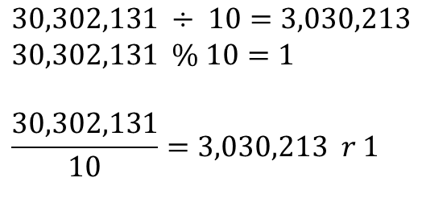
Divide by 10?
( | 3 | 0 | 3 | 0 | 2 | 1 | 3 | 1 | )₁₀
$$30,302,131 ÷ 10=3,030,213$$
$$30,302,131 \% 10=1$$
$$\frac{30,302,131}{10}=3,030,213 r 1$$
Notes:
3×10^7+ 3×10^6+ 3×10^5+ 3×10^10+ 2×10^3+ 1×10^2+ 3×10^1+ 1×10^0 =

Slide 130
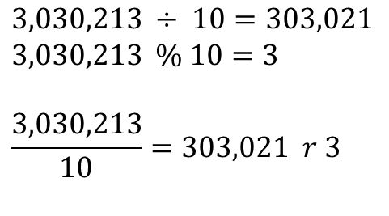
Divide by 10?
( | 3 | 0 | 3 | 0 | 2 | 1 | 3 | 1 | )₁₀
$$3,030,213 ÷ 10=303,021$$
$$3,030,213 \% 10=3$$
$$\frac{3,030,213}{10}=303,021 r 3$$
Notes:
3×10^7+ 3×10^6+ 3×10^5+ 3×10^10+ 2×10^3+ 1×10^2+ 3×10^1+ 1×10^0 =

Slide 131
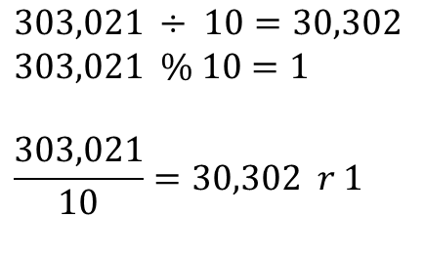
Divide by 10?
( | 3 | 0 | 3 | 0 | 2 | 1 | 3 | 1 | )₁₀
$$303,021 ÷ 10=30,302$$
$$303,021 \% 10=1$$
$$\frac{303,021}{10}=30,302 r 1$$
Notes:
3×10^7+ 3×10^6+ 3×10^5+ 3×10^10+ 2×10^3+ 1×10^2+ 3×10^1+ 1×10^0 =

Slide 132
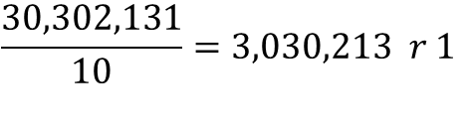
What is the digit in the position with significance of 10⁰?
$$\frac{30,302,131}{10}=3,030,213 r 1$$
Remainder of the 0+1 division by 10!
Notes:
3×10^7+ 3×10^6+ 3×10^5+ 3×10^10+ 2×10^3+ 1×10^2+ 3×10^1+ 1×10^0 =

Slide 133
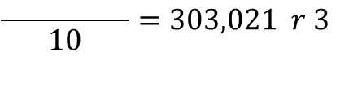
What is the digit in the position with significance of 10¹?
$$\frac{30,302,131}{10}=3,030,213 r 1$$
$$\frac{ }{10}=303,021 r 3$$
Remainder of the 1+1 division by 10!
Notes:
3×10^7+ 3×10^6+ 3×10^5+ 3×10^10+ 2×10^3+ 1×10^2+ 3×10^1+ 1×10^0 =

Slide 134
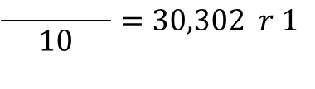
What is the digit in the position with significance of 10²?
$$\frac{30,302,131}{10}=3,030,213 r 1$$
$$\frac{ }{10}=303,021 r 3$$
$$\frac{ }{10}=30,302 r 1$$
Remainder of the 2+1 division by 10!
Notes:
3×10^7+ 3×10^6+ 3×10^5+ 3×10^10+ 2×10^3+ 1×10^2+ 3×10^1+ 1×10^0 =

Slide 135
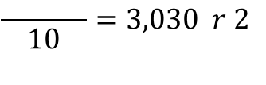
What is the digit in the position with significance of 10³?
$$\frac{30,302,131}{10}=3,030,213 r 1$$
$$\frac{ }{10}=303,021 r 3$$
$$\frac{ }{10}=30,302 r 1$$
$$\frac{ }{10}=3,030 r 2$$
Remainder of the 3+1 division by 10!
Notes:
3×10^7+ 3×10^6+ 3×10^5+ 3×10^10+ 2×10^3+ 1×10^2+ 3×10^1+ 1×10^0 =

Slide 136
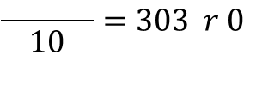
What is the digit in the position with significance of 10⁴?
$$\frac{30,302,131}{10}=3,030,213 r 1$$
$$\frac{ }{10}=303,021 r 3$$
$$\frac{ }{10}=30,302 r 1$$
$$\frac{ }{10}=3,030 r 2$$
$$\frac{ }{10}=303 r 0$$
Remainder of the 4+1 division by 10!
Notes:
3×10^7+ 3×10^6+ 3×10^5+ 3×10^10+ 2×10^3+ 1×10^2+ 3×10^1+ 1×10^0 =

Slide 137
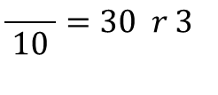
What is the digit in the position with significance of 10⁵?
$$\frac{30,302,131}{10}=3,030,213 r 1$$
$$\frac{ }{10}=303,021 r 3$$
$$\frac{ }{10}=30,302 r 1$$
$$\frac{ }{10}=3,030 r 2$$
$$\frac{ }{10}=303 r 0$$
$$\frac{ }{10}=30 r 3$$
Remainder of the 5+1 division by 10!
Notes:
3×10^7+ 3×10^6+ 3×10^5+ 3×10^10+ 2×10^3+ 1×10^2+ 3×10^1+ 1×10^0 =

Slide 138
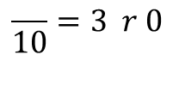
What is the digit in the position with significance of 10⁶?
$$\frac{30,302,131}{10}=3,030,213 r 1$$
$$\frac{ }{10}=303,021 r 3$$
$$\frac{ }{10}=30,302 r 1$$
$$\frac{ }{10}=3,030 r 2$$
$$\frac{ }{10}=303 r 0$$
$$\frac{ }{10}=30 r 3$$
$$\frac{ }{10}=3 r 0$$
Remainder of the 6+1 division by 10!
Notes:
3×10^7+ 3×10^6+ 3×10^5+ 3×10^10+ 2×10^3+ 1×10^2+ 3×10^1+ 1×10^0 =

Slide 139
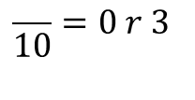
What is the digit in the position with significance of 10⁷?
$$\frac{30,302,131}{10}=3,030,213 r 1$$
$$\frac{ }{10}=303,021 r 3$$
$$\frac{ }{10}=30,302 r 1$$
$$\frac{ }{10}=3,030 r 2$$
$$\frac{ }{10}=303 r 0$$
$$\frac{ }{10}=30 r 3$$
$$\frac{ }{10}=3 r 0$$
$$\frac{ }{10}=0 r 3$$
Remainder of the 7+1 division by 10!
Notes:
3×10^7+ 3×10^6+ 3×10^5+ 3×10^10+ 2×10^3+ 1×10^2+ 3×10^1+ 1×10^0 =

Slide 140
What is the digit in the position with significance of 10^{i}?
$$\frac{30,302,131}{10}=3,030,213 r 1$$
$$\frac{ }{10}=303,021 r 3$$
$$\frac{ }{10}=30,302 r 1$$
$$\frac{ }{10}=3,030 r 2$$
$$\frac{ }{10}=303 r 0$$
$$\frac{ }{10}=30 r 3$$
$$\frac{ }{10}=3 r 0$$
$$\frac{ }{10}=0 r 3$$
( | 3 | 0 | 3 | 0 | 2 | 1 | 3 | 1 | )₁₀
Notes:
3×10^7+ 3×10^6+ 3×10^5+ 3×10^10+ 2×10^3+ 1×10^2+ 3×10^1+ 1×10^0 =

Slide 141
(░)₁₆ ← (░)₁₀

Slide 142
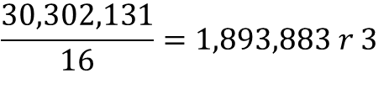
What is the digit in the position with significance of 16⁰?
$$\frac{30,302,131}{16}=1,893,883 r 3$$
Remainder of the 0+1 division by 16!
Notes:
3×10^7+ 3×10^6+ 3×10^5+ 3×10^10+ 2×10^3+ 1×10^2+ 3×10^1+ 1×10^0 =

Slide 143
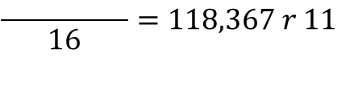
What is the digit in the position with significance of 16¹?
$$\frac{30,302,131}{16}=1,893,883 r 3$$
$$\frac{ }{16}=118,367 r 11$$
Remainder of the 1+1 division by 16!
Notes:
3×10^7+ 3×10^6+ 3×10^5+ 3×10^10+ 2×10^3+ 1×10^2+ 3×10^1+ 1×10^0 =

Slide 144
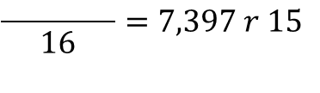
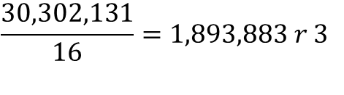
What is the digit in the position with significance of 16²?
$$\frac{30,302,131}{16}=1,893,883 r 3$$
$$\frac{ }{16}=118,367 r 11$$
$$\frac{ }{16}=7,397 r 15$$
Remainder of the 2+1 division by 16!
Notes:
3×10^7+ 3×10^6+ 3×10^5+ 3×10^10+ 2×10^3+ 1×10^2+ 3×10^1+ 1×10^0 =

Slide 145
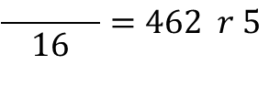
What is the digit in the position with significance of 16³?
$$\frac{30,302,131}{16}=1,893,883 r 3$$
$$\frac{ }{16}=118,367 r 11$$
$$\frac{ }{16}=7,397 r 15$$
$$\frac{ }{16}=462 r 5$$
Remainder of the 3+1 division by 16!
Notes:
3×10^7+ 3×10^6+ 3×10^5+ 3×10^10+ 2×10^3+ 1×10^2+ 3×10^1+ 1×10^0 =

Slide 146
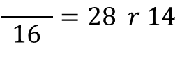
What is the digit in the position with significance of 16⁴?
$$\frac{30,302,131}{16}=1,893,883 r 3$$
$$\frac{ }{16}=118,367 r 11$$
$$\frac{ }{16}=7,397 r 15$$
$$\frac{ }{16}=462 r 5$$
$$\frac{ }{16}=28 r 14$$
Remainder of the 4+1 division by 16!
Notes:
3×10^7+ 3×10^6+ 3×10^5+ 3×10^10+ 2×10^3+ 1×10^2+ 3×10^1+ 1×10^0 =

Slide 147
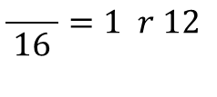
What is the digit in the position with significance of 16⁵?
$$\frac{30,302,131}{16}=1,893,883 r 3$$
$$\frac{ }{16}=118,367 r 11$$
$$\frac{ }{16}=7,397 r 15$$
$$\frac{ }{16}=462 r 5$$
$$\frac{ }{16}=28 r 14$$
$$\frac{ }{16}=1 r 12$$
Remainder of the 5+1 division by 16!
Notes:
3×10^7+ 3×10^6+ 3×10^5+ 3×10^10+ 2×10^3+ 1×10^2+ 3×10^1+ 1×10^0 =

Slide 148
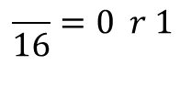
What is the digit in the position with significance of 16⁶?
$$\frac{30,302,131}{16}=1,893,883 r 3$$
$$\frac{ }{16}=118,367 r 11$$
$$\frac{ }{16}=7,397 r 15$$
$$\frac{ }{16}=462 r 5$$
$$\frac{ }{16}=28 r 14$$
$$\frac{ }{16}=1 r 12$$
$$\frac{ }{16}=0 r 1$$
Remainder of the 6+1 division by 16!
Notes:
3×10^7+ 3×10^6+ 3×10^5+ 3×10^10+ 2×10^3+ 1×10^2+ 3×10^1+ 1×10^0 =

Slide 149
What is the digit in the position with significance of 16⁶?
$$\frac{30,302,131}{16}=1,893,883 r 3$$
$$\frac{ }{16}=118,367 r 11$$
$$\frac{ }{16}=7,397 r 15$$
$$\frac{ }{16}=462 r 5$$
$$\frac{ }{16}=28 r 14$$
$$\frac{ }{16}=1 r 12$$
$$\frac{ }{16}=0 r 1$$
( | 1 | 12 | 14 | 5 | 15 | 11 | 3 | )₁₆
Notes:
3×10^7+ 3×10^6+ 3×10^5+ 3×10^10+ 2×10^3+ 1×10^2+ 3×10^1+ 1×10^0 =

Slide 150
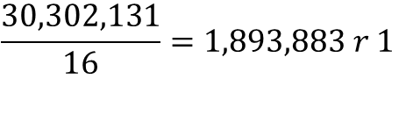
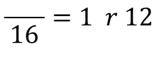
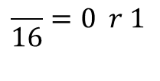
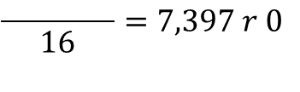
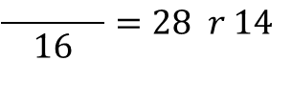
What is the digit in the position with significance of 16⁶?
$$\frac{30,302,131}{16}=1,893,883 r 1$$
$$\frac{ }{16}=118,367 r 11$$
$$\frac{ }{16}=7,397 r 0$$
$$\frac{ }{16}=462 r 5$$
$$\frac{ }{16}=28 r 14$$
$$\frac{ }{16}=1 r 12$$
$$\frac{ }{16}=0 r 1$$
( | 1 | 12 | 14 | 5 | 15 | 11 | 3 | )₁₆
Notes:
1CE5FB3

Slide 151
1,2,3,4,5,6,7,8,9,A
1,2,3,4,5,6,7,8,9,B
1,2,3,4,5,6,7,8,9,C
1,2,3,4,5,6,7,8,9,D
1,2,3,4,5,6,7,8,9,E
1,2,3,4,5,6,7,8,9,F
= 9 + 1
= A + 1
= B + 1
= C + 1
= D + 1
= E + 1
= (10)₁₀
= (11)₁₀
= (12)₁₀
= (13)₁₀
= (14)₁₀
= (15)₁₀

Slide 152
What is the digit in the position with significance of 16⁶?
$$\frac{30,302,131}{16}=1,893,883 r 1$$
$$\frac{ }{16}=118,367 r 11$$
$$\frac{ }{16}=7,397 r 0$$
$$\frac{ }{16}=462 r 5$$
$$\frac{ }{16}=28 r 14$$
$$\frac{ }{16}=1 r 12$$
$$\frac{ }{16}=0 r 1$$
( | 1 | C | E | 5 | F | B | 3 | )₁₆
Notes:
1CE5FB3

Slide 153
(░)₈ ← (░)₁₀

Slide 154
What is the digit in the position with significance of 8^{i}?
Quotient | Remainder
30,302,131÷8 | 3
3787766÷8 | 6
473470÷8 | 6
59183÷8 | 7
7397÷8 | 5
924÷8 | 4
115÷8 | 3
14÷8 | 6
1÷8 | 1
0
(1CE5FB3)₁₆
(30,302,131)₁₀
(163457663)₈

Slide 155
(░)₄ ← (░)₁₀

Slide 156
What is the digit in the position with significance of 4^{i}?
Quotient | Remainder
30,302,131÷4 | 3
7575532÷4 | 0
1893883÷4 | 3
473470÷4 | 2
118367÷4 | 3
29591÷4 | 3
7397÷4 | 1
1849÷4 | 1
462÷4 | 2
115÷4 | 3
28÷4 | 0
7÷4 | 3
1÷4 | 1
0
(1CE5FB3)₁₆
(30,302,131)₁₀
(163457663)₈
(1303211332303)₄

Slide 157
(░)₂ ← (░)₁₀

Slide 158
What is the digit in the position with significance of 2^{i}?
Quotient | Remainder
30,302,131÷2 | 1
15151065÷2 | 1
7575532÷2 | 0
3787766÷2 | 0
1893883÷2 | 1
946941÷2 | 1
473470÷2 | 0
236735÷2 | 1
118367÷2 | 1
59183÷2 | 1
29591÷2 | 1
14795÷2 | 1
7397÷2 | 1
3698÷2 | 0
1849÷2 | 1
924÷2 | 0
462÷2 | 0
231÷2 | 1
115÷2 | 1
57÷2 | 1
28÷2 | 0
14÷2 | 0
7÷2 | 1
3÷2 | 1
1÷2 | 1
0
(1CE5FB3)₁₆
(30,302,131)₁₀
(163457663)₈
(1303211332303)₄
(1110011100101111110110011)₂

Slide 159
(░)_{r} ← (░)₁₀
1. Divide quotients by r
2. Keep the remainders as the digits in r
3. Put the remainders in reverse order
For r > 10, substitute the digits with valid digits, e.g., in Base-16: 15→F

Slide 160
(░)_{r} → (░)_{r’}
Any Base-r to Any Base-r’

Slide 161
(░)_{r} (░)_{r’}
→
→
(░)₁₀
Mediate through Base-10
Base-r → Base-10 → Base-r’

Slide 162
(1CE5FB3)₁₆→1×16⁶+C×16⁵+E×16⁴+5×16³+F×16²+B×16¹+3×16⁰
(1CE5FB3)₁₆→1×16⁶+12×16⁵+14×16⁴+5×16³+15×16²+11×16¹+3×16⁰
(1CE5FB3)₁₆→ (30,302,131)₁₀
(1CE5FB3)₁₆
Quotient | Remainder
30,302,131÷8 | 3
3787766÷8 | 6
473470÷8 | 6
59183÷8 | 7
7397÷8 | 5
924÷8 | 4
115÷8 | 3
14÷8 | 6
1÷8 | 1
0
→ (163457663)₈
Notes:
1CE5FB3

Slide 163
Fraction conversion

Slide 164
(0.░)₁₀ ← (0.░)₁₀
To Come up with an Algorithm!

Slide 165
What is the digit in the position with significance of 10^{-i}?
(0.26501)₁₀ → 10⁻¹ → 2
(0.26501)₁₀ → 10⁻² → 6
(0.26501)₁₀ → 10⁻³ → 5
(0.26501)₁₀ → 10⁻⁴ → 0
(0.26501)₁₀ → 10⁻⁵ → 1
Notes:
3×10^7+ 3×10^6+ 3×10^5+ 3×10^10+ 2×10^3+ 1×10^2+ 3×10^1+ 1×10^0 =

Slide 166
What is the digit in the position with significance of 10^{-i}?
(0.26501)₁₀ → 10⁻¹ → 2
(0.6501)₁₀ → 10⁻¹ → 6
(0.501)₁₀ → 10⁻¹ → 5
(0.01)₁₀ → 10⁻¹ → 0
(0.1)₁₀ → 10⁻¹ → 1
Notes:
3×10^7+ 3×10^6+ 3×10^5+ 3×10^10+ 2×10^3+ 1×10^2+ 3×10^1+ 1×10^0 =

Slide 167
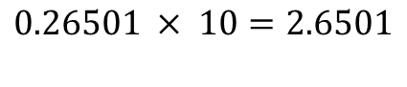
Multiply by 10?
( | 0 | . | 2 | 6 | 5 | 0 | 1 | )₁₀
$$\text{0.26501} × 10=2.6501$$
Notes:
0.26501 * 10

Slide 168
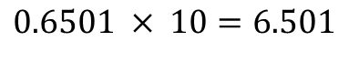
Multiply by 10?
( | 0 | . | 2 | 6 | 5 | 0 | 1 | )₁₀
$$\text{0.6501} × 10=6.501$$
Notes:
0.26501 * 10

Slide 169
Fraction | Result | Integer Part
0.26501×10 | 2.6501 | 2
0.6501×10 | 6.501 | 6
0.501×10 | 5.01 | 5
0.01×10 | 0.1 | 0
0.1×10 | 1.0 | 1
0

Slide 170
(0.░)₁₆ ← (0.░)₁₀

Slide 171
Fraction | Result | Integer Part
0.26501×16 | 4.24016 | 4
0.24016×16 | 3.84256 | 3
0.84256×16 | 13.48096 | 13 = D
0.48096×16 | 7.69536 | 7
0.69536×16 | 11.12576 | 11 = B
0.12576×16 | 2.01216 | 2
0.01216×16 | 0.19456 | 0
0.194560006×16 | 3.11296 | 3
0.1129601×16 | 1.807362 | 1
0.807361603×16 | 12.91779 | 12 = C
0.917785645×16 | 14.68457 | 14 = E
0.684570313×16 | 10.95313 | 10 = A
0.953125×16 | 15.25 | 15 = F
0.25×16 | 4 | 4
0 | 0 | 0
(0.26501)₁₀ → (0.43D7B2031CEAF40)₁₆
Notes:
43 13 7 11 2031 12 14 10 15 40

Slide 172
(0.░)₈ ← (0.░)₁₀
(0.░)₄ ← (0.░)₁₀
(0.░)₂ ← (0.░)₁₀
_{Microsoft excel sheet}

Slide 173
(░.░)_{r} (░.░)_{r’}
→
→
(░.░)₁₀
Integer Part independent of Fraction Part!

Slide 174
(░ .)_{r} (░ .)_{r’}
→
→
(░ .)₁₀
Integer Part

Slide 175
(. ░)_{r} (. ░)_{r’}
→
→
(. ░)₁₀
Fraction Part

Slide 176
(30,302,131. 26501)₁₀ | (163457663.20753….)₈
Quotient | Remainder
30,302,131÷8 | 3
3787766÷8 | 6
473470÷8 | 6
59183÷8 | 7
7397÷8 | 5
924÷8 | 4
115÷8 | 3
14÷8 | 6
1÷8 | 1
0
Fraction | Result | Integer Part
0.26501×8 | 2.12008 | 2
0.12008×8 | 0.96064 | 0
0.96064×8 | 7.68512 | 7
0.68512×8 | 5.48096 | 5
0.48096×8 | 3.84768 | 3
0.84768×8 | 6.78144 | 6
0.78144×8 | 6.25152 | 6
0.25152×8 | 2.01216 | 2
0.01216×8 | 0.09728 | 0
… | … | …

Slide 177
Base-2 → Base-[2², 2³, 2⁴, 2^{n}]
_{Lecture assignment}

Slide 178
Base-2 ← Base-[2², 2³, 2⁴, 2^{n}]
_{Lecture assignment}

Slide 179
https://planetcalc.com/862/

Slide 180
arithmetic

